Slide 1
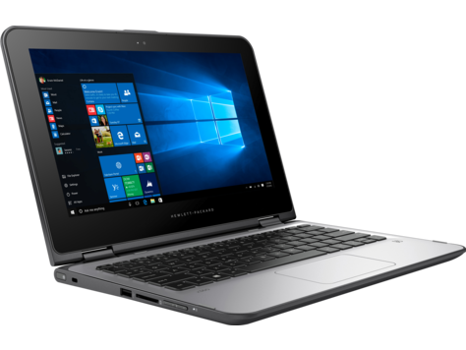
Welcome Back to Marine Science 2 days down, 178 to go!!!
Please sit in the same seats as Monday and Tuesday, Open up your laptops, go to MrHyatt.rocks, and do today’s bellwork

Slide 2
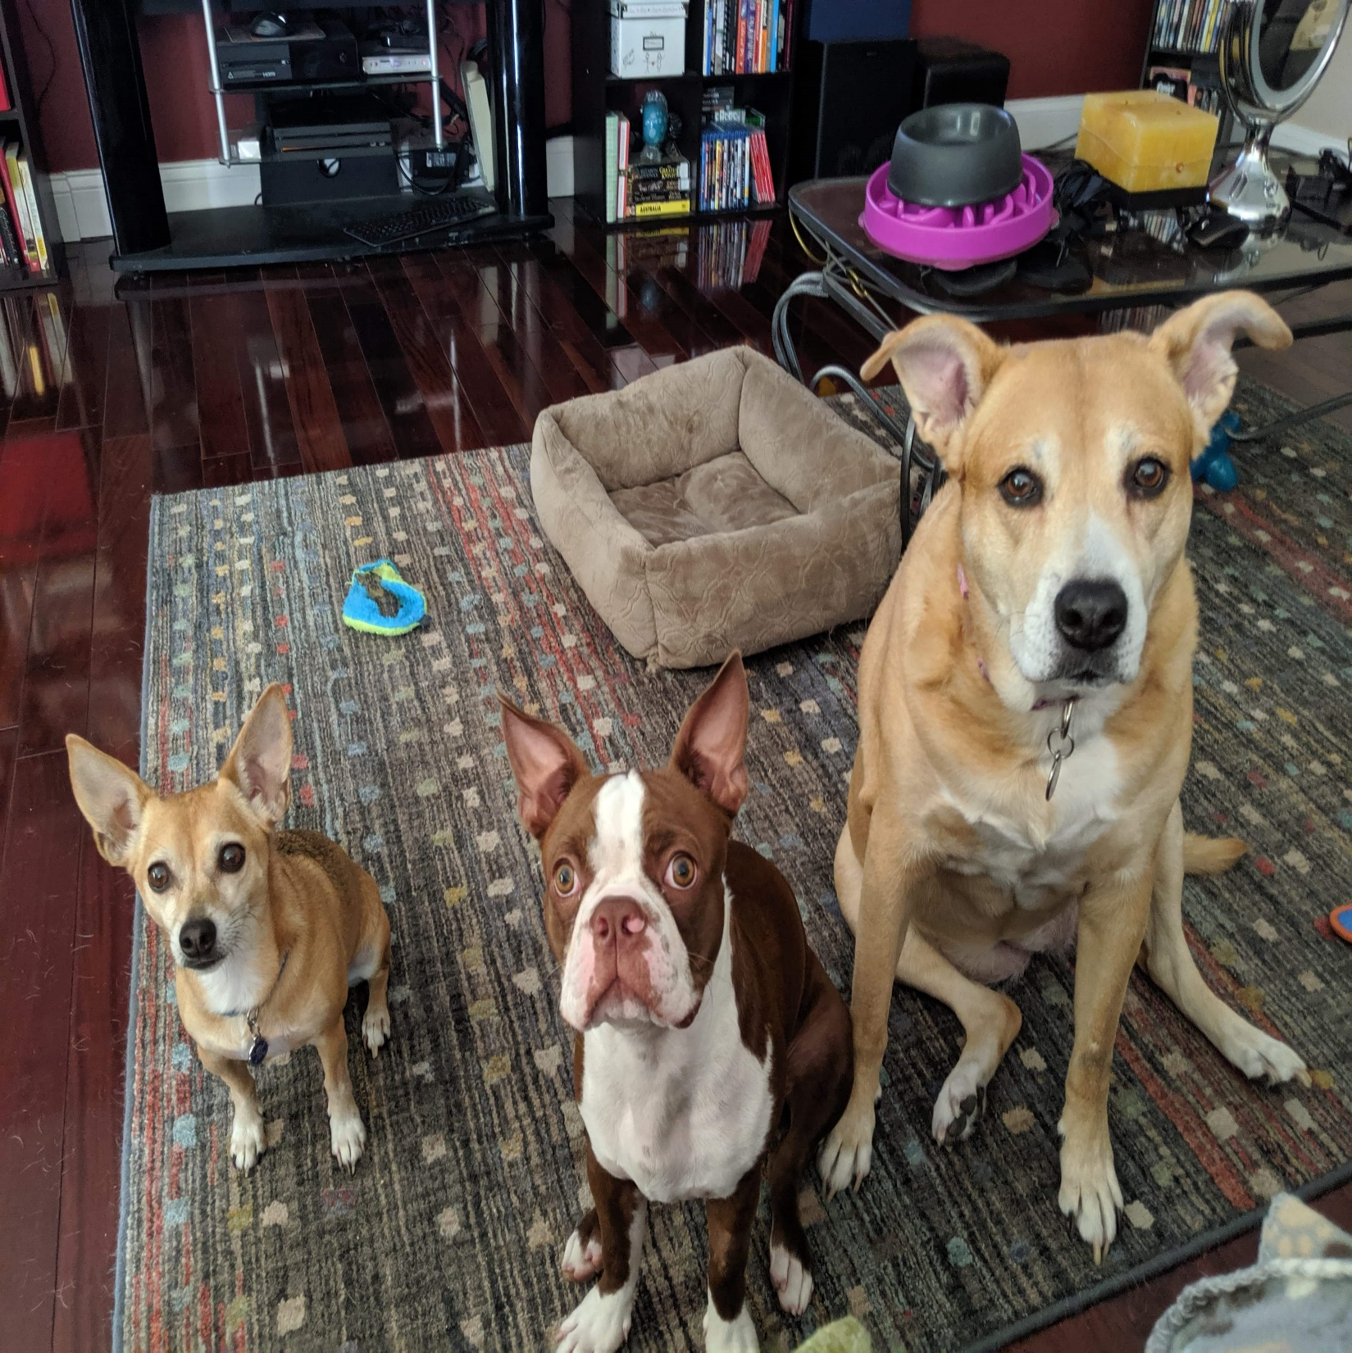
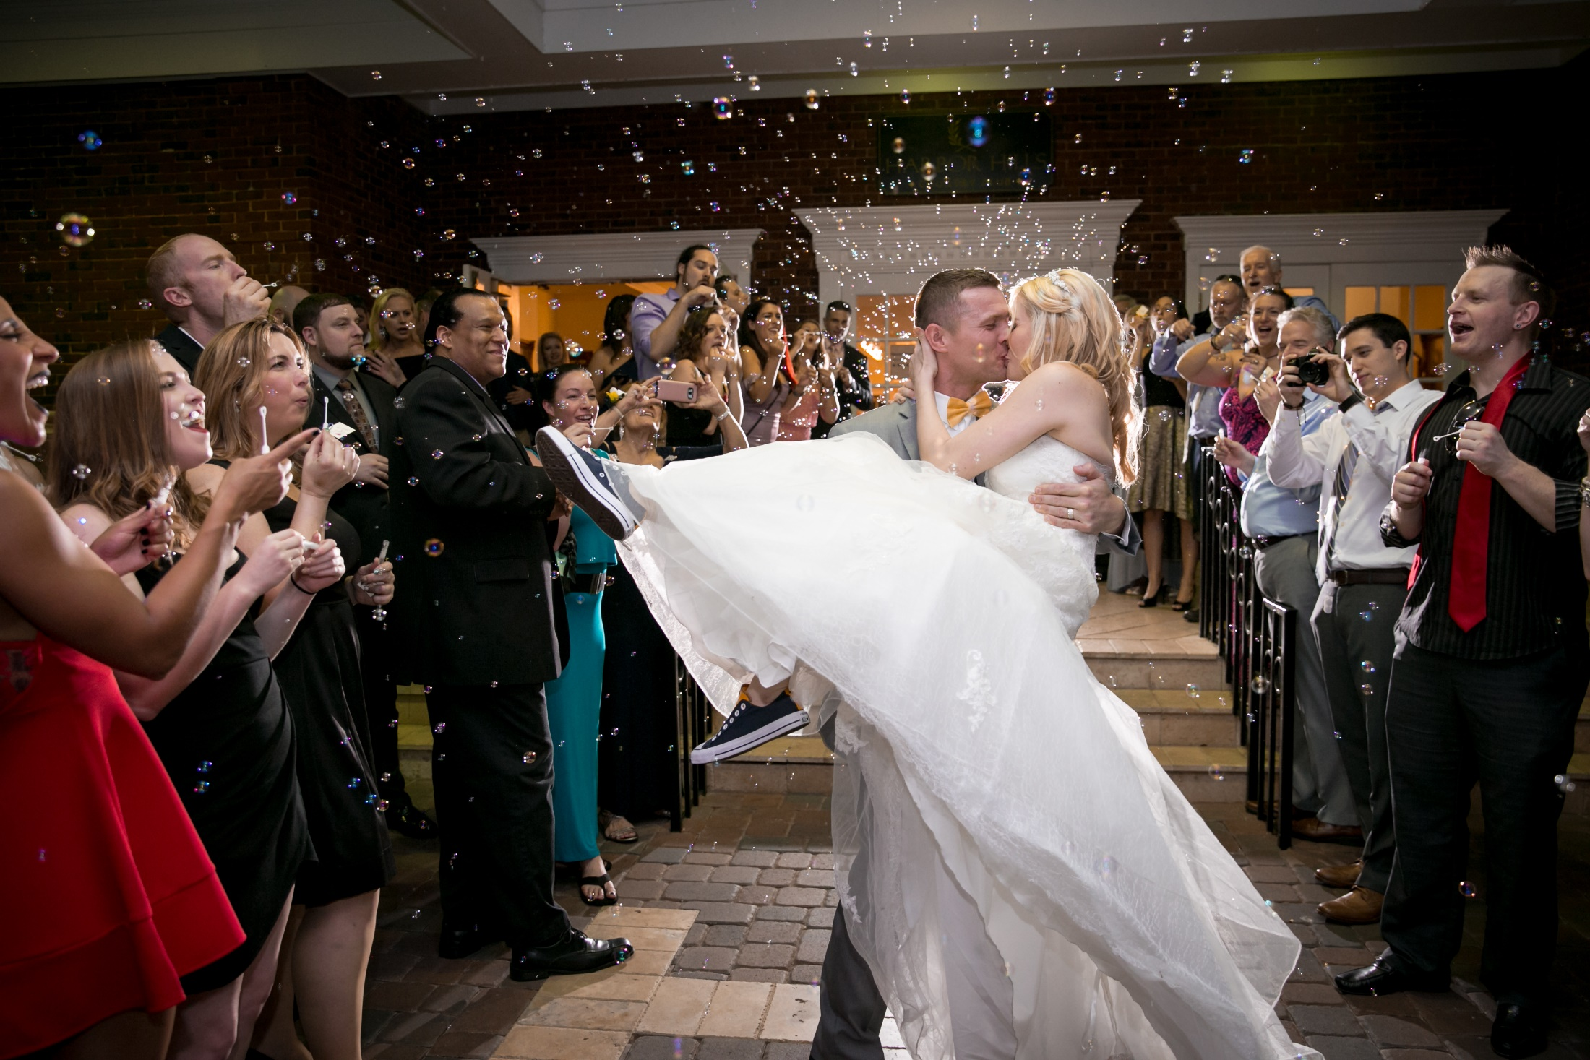
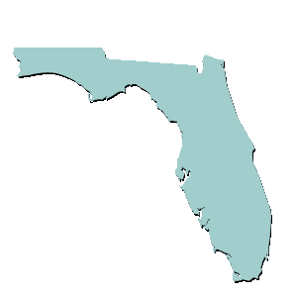
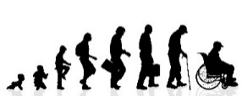
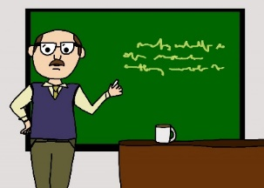
Mr. Hyatt – Fun Facts
I am from Michigan, I went to Michigan, I root for Michigan! Go Blue!
I’ve lived in Florida over a decade
I am between one and a million years old
I have 10 pets (3 dogs, 2 cats, 1 bird, 4 snakes)
This is my fifth year teaching Astronomy, and first year teaching marine science. In the past I’ve taught: Biology, Botany, Earth-Space Science, Physical Science, and Life Science
I got married last year!

Slide 3
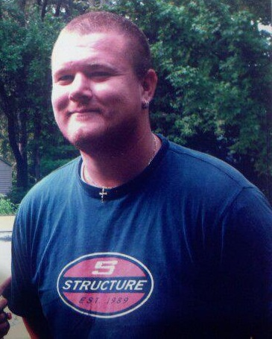
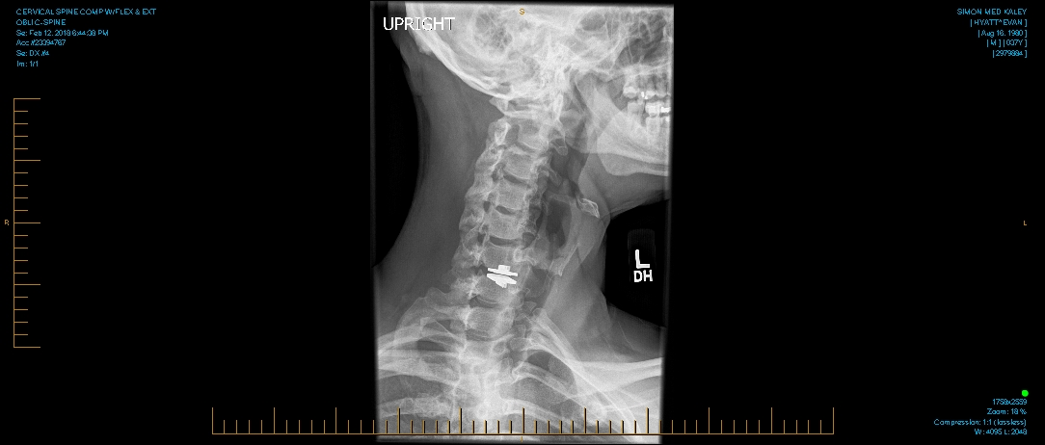
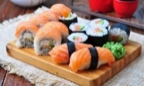
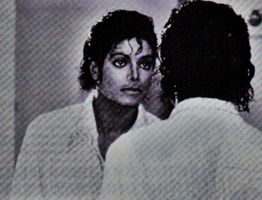
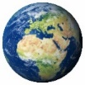
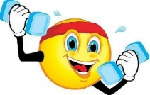
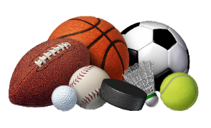
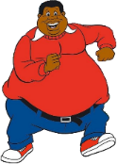
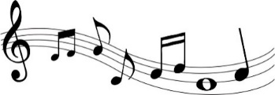
Mr. Hyatt – Fun Facts
My favorite:
number is
favorite food is Sushi
favorite color is Blue
favorite song is “Man in the Mirror”
favorite holiday is my birthday
favorite planet is Earth
In my free time, I either read, exercise, or watch sports on TV (I used to play a lot of video games)
I used to be really fat. ☹
I played trumpet from 4th grade to Junior year of college
Both of my parents were teachers (Mom → Choir, Step-Dad → Band)
I had neck surgery last year, and now am part metal

Slide 4
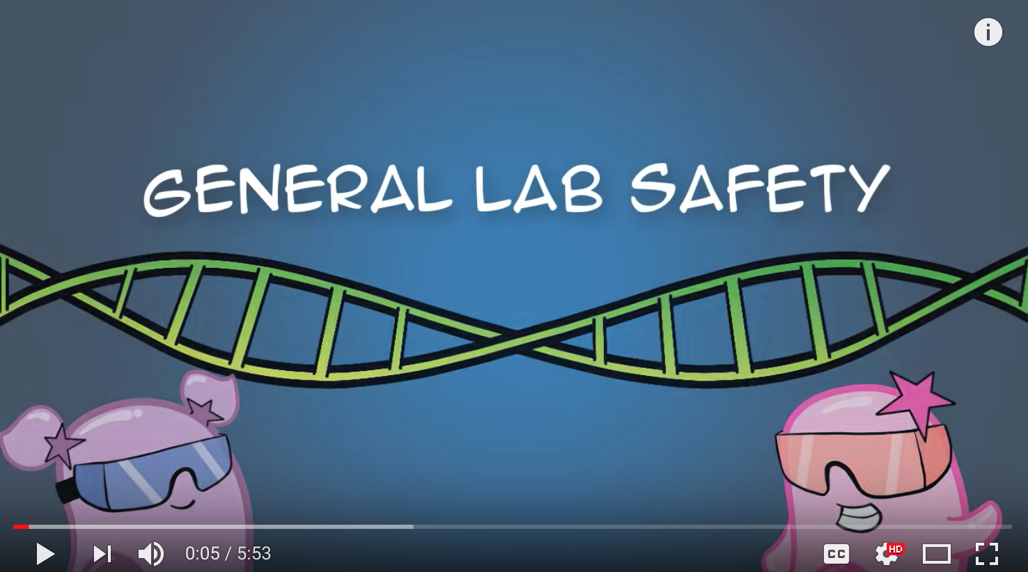
https://www.youtube.com/watch?v=MEIXRLcC6RA
Lab Safety Video

Slide 5
LAB
In order to do labs in here, you MUST complete this quiz with at least an 80%! (28 correct)
Every single answer is given to you, you just need to find it.
Take your time

Slide 6
Use the contract to answer the questions on the answer sheet
Safety Contract
Your answer sheet

