Slide 1
Open up your laptops, go to MrHyatt.rocks, and do today’s bellwork…then put your computer away…
Scale | Scale Description
4 | develop a strategy to solve a scientific problem. use diagrams and models to represent and solve a scientific problem explain ways in which a scientific problem can be solved.
3 | You Can: define a problem based on a specific body of knowledge conduct systematic observations use tools to gather, analyze, and interpret data pose answers, explanations, or descriptions of events use appropriate evidence and reasoning to justify these explanations to others communicate results of scientific investigations
2 | You Can: determine the meaning of symbols, key terms, and other astronomy specific words define a scientific problem describe the safety precautions that should be taken when starting a specific scientific investigation
1 | You Can: recognize from a list the key parts of a specific body of knowledge define a scientific problem state the safety precautions that should be taken when starting a specific scientific investigation

Slide 2
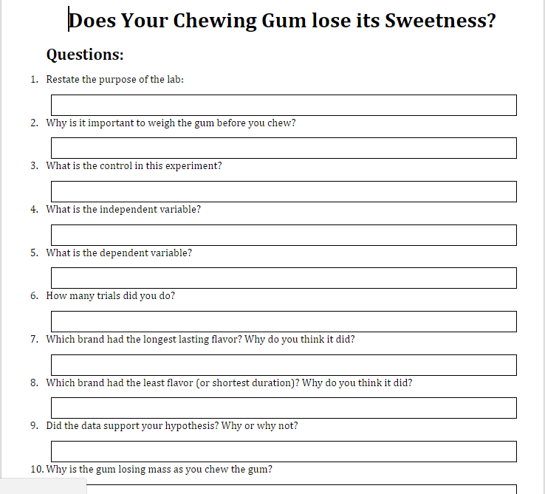
GUM LAB QUESTIONS
Due at Midnight tonight!!

Slide 3
Group Work
This is “lab” number 2
You will be graded as a group – so please work together
Make sure all of your names are on the answer sheet

Slide 4
Group Work
You will be graded as a group – so please work together
Make sure all of your names are on the answer sheet

Slide 5
Group Work!
Take the piece of notebook paper I have given you. PUT EVERYBODIES NAME ON IT!
As a group, you will answer the 7 questions from around the room. You will rotate counter-clockwise.
Each person in your group will write the answer to at least one of the questions.
Write your initials down next to the question that you wrote!
If you have three people, more people will have to write twice.
You will have 42 minutes / 7 questions = about 6 minutes per question
Each Question must be answered with AT LEAST A 5 SENTENCE PARAGRAPH. (start promptly)
If I see somebody not helping their group, or not participating, or on their phone – the group loses points.

