Slide 1
Open up your laptops, go to MrHyatt.rocks, and do today’s bellwork
(If you cannot access the website, try to hard reset your computer)

Slide 2
Scale | Scale Description
4 | Through independent work beyond what was taught in class, students could: research a problem based on a specific body of knowledge. develop a strategy to solve a scientific problem. use diagrams and models to represent and solve a scientific problem.
3 | define a problem based on a specific body of knowledge plan investigations conduct systematic observations use tools to gather, analyze, and interpret data pose answers, explanations, or descriptions of events use appropriate evidence and reasoning to justify these explanations to others communicate results of scientific investigations
2 | determine the meaning of symbols, key terms, and other astronomy specific words and phrases define a scientific problem
1 | label given pieces of laboratory equipment and describe their uses describe the safety precautions that should be taken when starting a specific scientific investigation list laboratory safety rules and procedures

Slide 3
Science journals and your selfie with them are due today

Slide 4
Take out your Composition Notebooks Please
Put your name
Subject
Class Period
On the cover

Slide 5
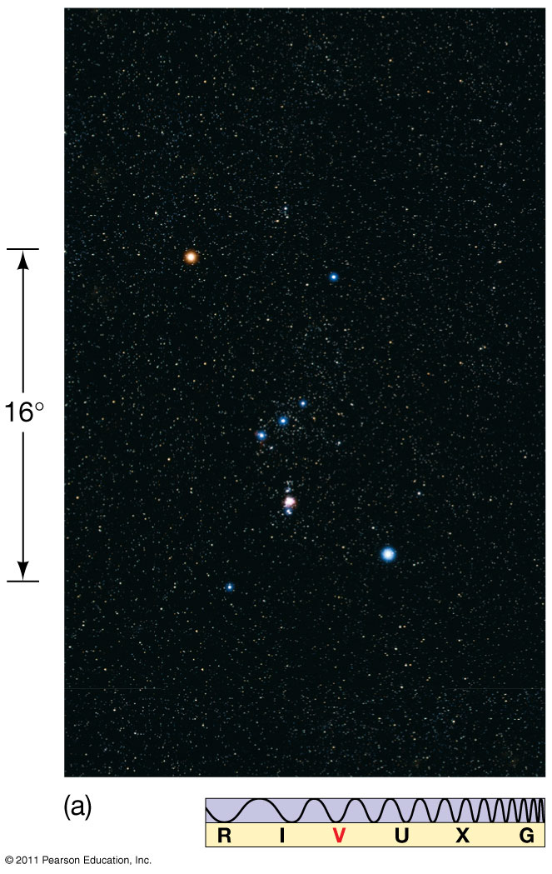
Science has for most of history, used only observations!
Simplest observation: Look at the world around you!
Notes:
Figure 1.8a. Caption: Constellation Orion. (a) A photograph of the group of bright stars that make up the constellation Orion. (See the preface for an explanation of the icon at the bottom, which simply indicates that this image was made in visible light.)

Slide 6
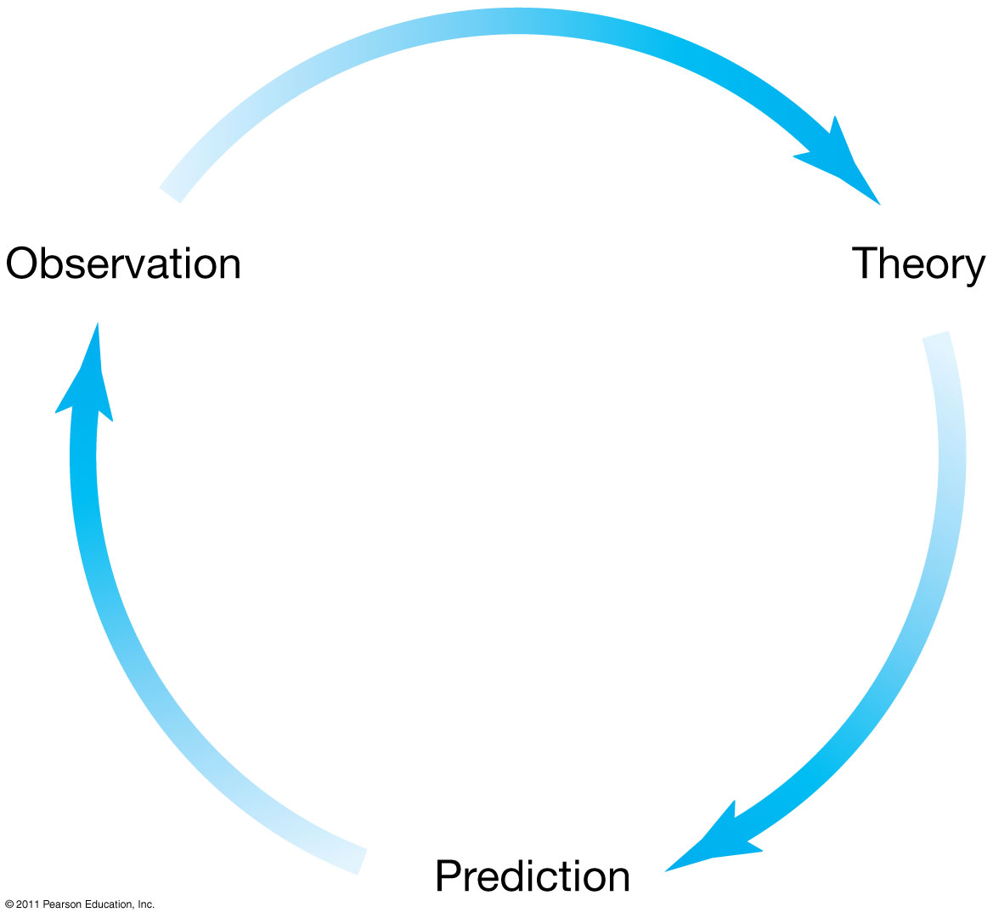
Scientific Theory and the Scientific Method
Observation leads to theory explaining it.
Theory explanation that leads to predictions consistent with previous observations.
Predictions of new phenomena. If future observations agree with the prediction, more predictions can be made. If not, a new theory should be made.
Notes:
Figure 1-6. Caption: Scientific Method. Scientific theories evolve through a combination of observation, theoretical reasoning, and prediction, which in turn suggests new observations. The process can begin at any point in the cycle (although it usually starts with observations), and it continues forever—or until the theory fails to explain an observation or makes a demonstrably false prediction.

Slide 7
Theory vs. Law
Theory– a scientific explanation of events in the natural world that’s been tested & is reliable
Explains the why
Based off of repeated observations and includes a well-supported hypotheses
Can be replaced/changed by new data

Slide 8
Theories Scientific theories are different than what people think it means in everyday English!!!
Theories have THE MOST EVIDENCE BACKING THEM UP!
Cells
Gravity
Evolution
Germ
Relativity
Plate Tectonics
Heliocentrism
Big Bang

Slide 10
Law– a rule to explain observations
Describes the what
Supported by extensive observations & experimentation
Often associated with a mathematical law
Theory vs. Law

Slide 11
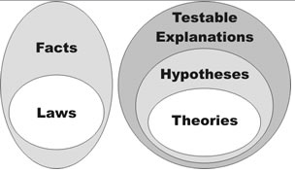
If there is a math equation, it is often a law. It’s a description, more than an explanation

Slide 13
A theory can never become proven “fact,” because it can always be invalidated, or forced to change, by a single contradictory observation. However, once a theory’s predictions have been repeatedly verified by experiments over many years, it is often widely regarded as “true.”

Slide 14
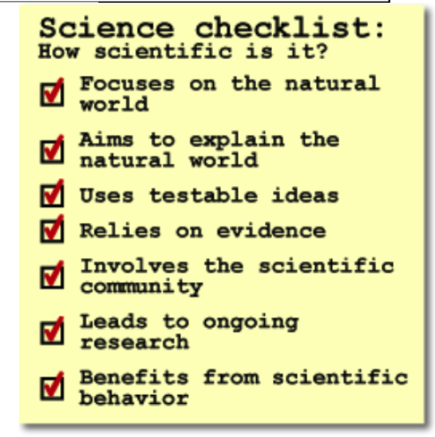
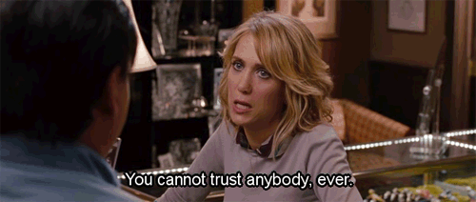
How credible is it?

Slide 15
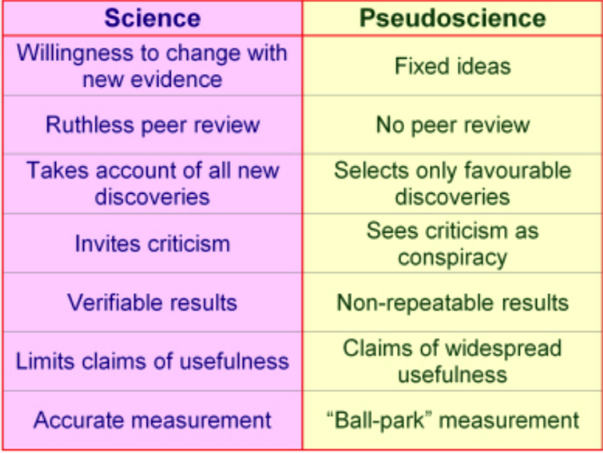
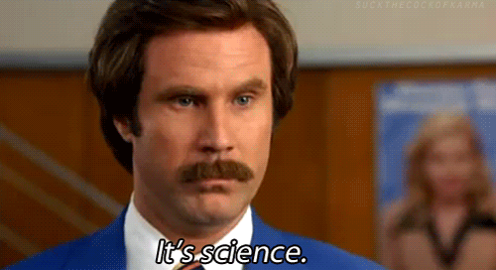
Science vs. Pseudoscience

Slide 16
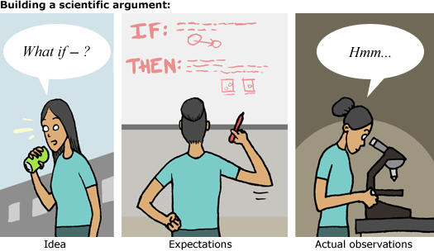
Characteristics of Scientific Arguments:
Evidence to back up claim
Arguments can be tested
Based on Facts rather than opinions
Supported by data, observations, and evidence
Scientific Arguments

Slide 17
For the rest of class: Article Summary
Read the article or watch the video (it is on MrHyatt.rocks) and then fill in the summary information on the answer sheet in Canvas
Due Monday at Midnight!

