Slide 1
Open up your laptops, go to MrHyatt.rocks, and do today’s bell work
We have A LOT to do today. Please get started!
Scale | Scale Description
4 | Through independent work beyond what was taught in class, students could (examples include, but are not limited to): research current and past earth and sun conditions. investigate causes and possible solutions for global climate change. compare and contrast the patterns in the organization and distribution of matter in the sun, earth, moon system. compare and contrast different solar events and their impact on earth.
3 | understand how the motions of the sun, stars and planets as observed from Earth relate to the motions of the Earth and other planets in space. understand how the movement and position of Earth influences life on Earth. be able to differentiate between astronomy and astrology.
2 | determine the meaning of symbols, key terms, and other astronomy specific words and phrases relating to the Earth, Sun and Moon illustrate the patterns of distribution of matter in the sun, earth, moon system. list the physical properties of the Earth, Sun and Moon. describe the key parts of the Earth, Sun and Moon System
1 | show the patterns of distribution of matter in the sun, earth, moon system. select from a list the physical properties of the sun, earth and moon. list the key parts of the structure of earth, sun and moon.

Slide 2
Test Yesterday
Hands on lab from Friday
Where did the Moon come from?

Slide 3
When you are done with bellwork, Please Create This
Theory | What it says | Correct/Incorrect because…
Fission Theory
Sister Theory
Capture Theory
Impact Theory
Where did the Moon come from?

Slide 4
Fill in your chart by reading this

Slide 5
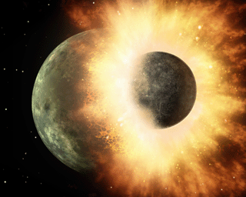
Formation of the Moon
Theia
Earth

Slide 6
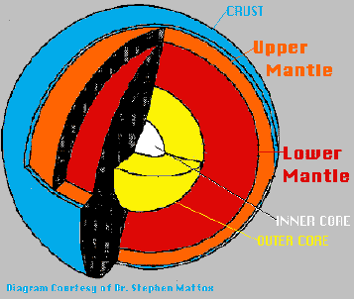
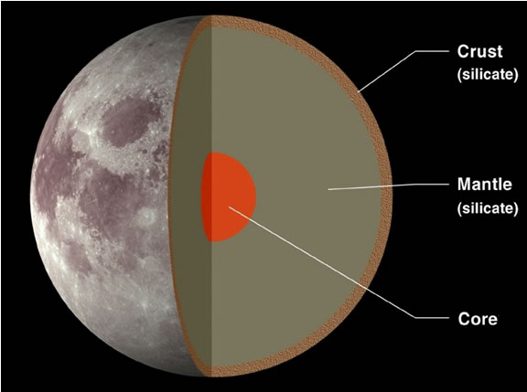
Structure of the Moon
The Moon is mostly made up of the same elements that our crust and upper mantle are made of

Slide 7
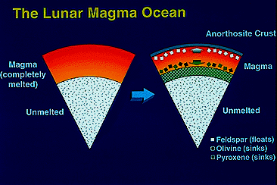
Notes:
This diagram depicts the magma ocean concept. When the Moon formed it was enveloped by a layer of molten rock (magma) hundreds of kilometers thick. As a magma crystallized, the minerals more dense than the magma sank while those less dense (such as feldspar) floated, forming the anorthosite crust. The dense minerals (olivine and pyroxene) later remelted to produce the basalts that compose the maria. (Graphics by Brooks Bays, University of Hawaii.)

Slide 8
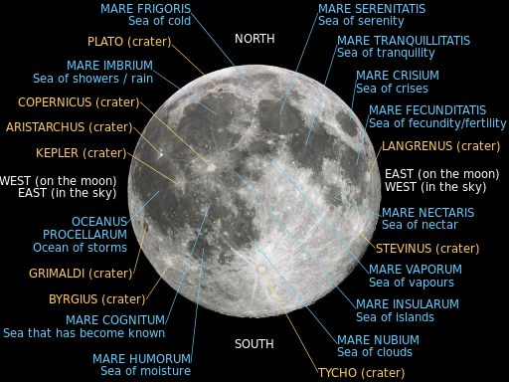
Facts about the Moon:
Large dark areas on the moon are called maria (singular: mare) meaning oceans or seas, because early observers thought that’s what they looked like. They are evidence of large impacts which left craters that were then filled in with molten material.

Slide 9
The moon is made up of rock and metal like earth, but has a very different density, so this shows the moon and the earth formed at different times.
Because of its large size (and large gravitational influence), it is believed the moon has helped to protect earth from past collisions.
Even though the moon is our closest celestial neighbor, it is still, on average 385,000 km (240,000mi, 1.3 light seconds) away from us.
The moon is still the only other place in the universe that humans have visited.

Slide 10
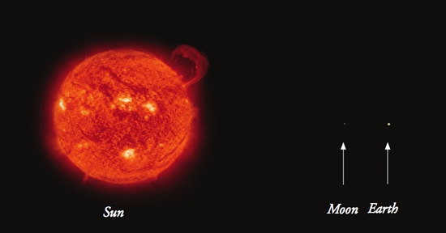
The Sun, Earth and the moon – to scale

Slide 12
This is better…(though not to scale)

Slide 14
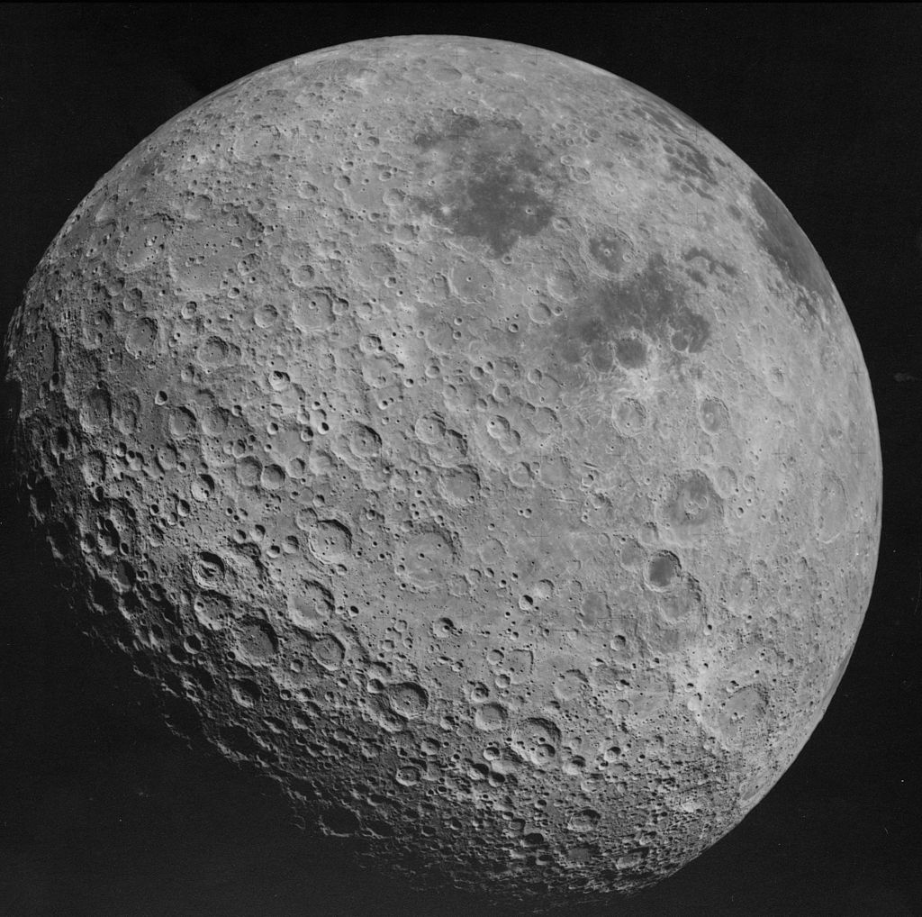
Far Side of the Moon

Slide 15
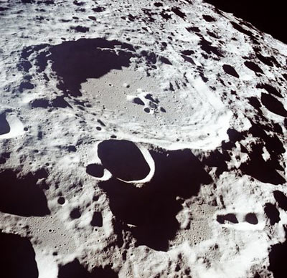
Millions of impact craters

Slide 16
No Atmosphere

Slide 17
Very Fine Regolith

Slide 19
The Moon:
Geologic History and
Future Exploration
Notes:
THE MOON: GEOLOGIC HISTORY AND FUTURE EXPLORATION
This set of 36 slides accompanies Exploring the Moon a teacher’s guide with activities for Earth and space sciences, NASA Publication #P-306. It tries to cover a lot of ground with only a few slides. The emphasis is on what the Apollo piloted and associated robotic missions taught us about the Moon’s geology, geologic history, and origin. We see a glimpse of how astronauts went about their business while exploring the Moon in person. The slides also give a brief history lesson on what we knew about the Moon from telescopic observations and other astronomic observations. The last several slides discuss some of the exciting possibilities that await us when we return to the Moon with people, this time to stay. (All slides are from NASA, except where noted.)

Slide 20
What we knew about the Moon before Apollo

Slide 21
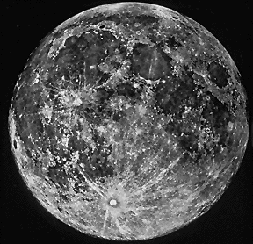
We knew what it looked like
*Photo from Lick Observatory
Notes:
This picture of the Moon was taken with a telescope at Lick Observatory, California. Before rockets streaked to the Moon, scientists knew that the Moon had two major types of terrain. The lighter terrain, called the highlands, is more heavily cratered and older than the darker, smoother maria a latin word meaning seas.” Many of the mountains in the highlands form large circles, called multi-ringed basins. The basins were thought by almost all scientists to have been made when large objects crashed into the Moon. (Link Observatory Photo, Copyright UC Regents; used with permission.)

Slide 22
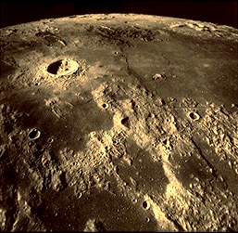
*Apollo 17
And that it had craters
Notes:
This is a view seen by Apollo 17 astronauts as they orbited the Moon. The maria are smoother, lower, and darker than the highlands. The crater in the upper left is 20 kilometers across. (AS17-M-1671)

Slide 23
Apollo Missions

Slide 24
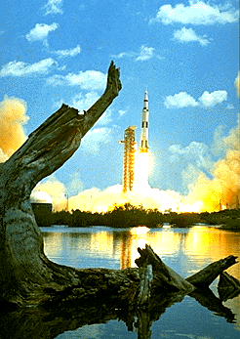
1972 launch of Apollo 16
All launched from Cape Canaveral at Kennedy Space Center
Notes:
Our knowledge increased dramatically beginning in 1969 when people rode great rocket ships to the Moon. This shows the launch in 1972 of the Apollo 16 mission to the landing site in the highlands of the Moon. In all, there were six Apollo landings to the Moon. In each case two astronauts descended to the Moon’s surface while a third remained in orbit around the Moon in the main spacecraft called the Command and Service Module. (S72-35347)

Slide 25
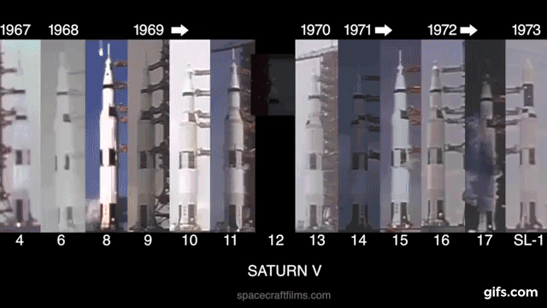

Slide 26
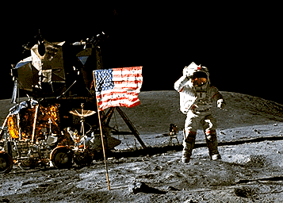
John Young, Commander of the Apollo 16 mission
*Named after a road in Orlando
Notes:
John Young, Commander of the Apollo 16 mission saluting the flag. The Lunar Module is behind Young, with the Lunar Roving Vehicle parked next to it. This picture shows several interesting features about the Moon. First, Commander Young is wearing a space suit. There is no air on the Moon, so astronauts must bring their life support systems with them. Notice that he has jumped about a meter off the ground, in spite of wearing the bulky space suit. In fact, Young and his extraterrestrial outfit weighed 150 kilograms on Earth. If gravity was the same on the Moon, nobody could jump so far off the ground! Also notice that there are no trees or bushes in sight, and the astronauts did not set up camp next to a babbling mountain stream. There is no life or flowing water on the Moon. (AS16-113-18339)

Slide 27
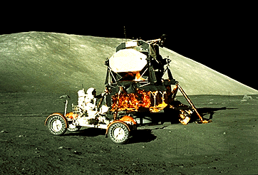
The last 3 had Moon Buggies
Notes:
Astronaut Harrison Schmitt driving the lunar dune buggy, officially called the Lunar Roving Vehicle, or LRV for short. The rover greatly enhanced lunar exploration on the last three Apollo missions by allowing much longer traverses around the landing sites. (AS17-147-22527)

Slide 28
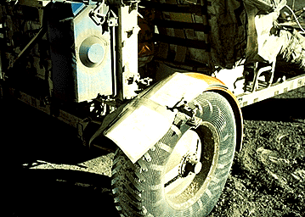
advantages people have over robots
Notes:
One of the great advantages people have over robots is their wonderful ability to solve problems. This slide shows how the Apollo 17 astronauts repaired a broken fender on their rover by using a map and duct tape. Without a fender, dust was being thrown both forwards and backwards, interfering with driving. (AS17-137-20979)

Slide 29
Astronaut activities on the lunar surface

Slide 30
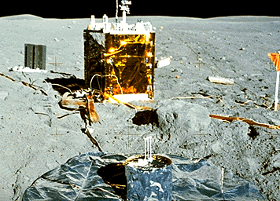
central station
the power supply
seismometer
Notes:
Many geophysical instruments were deployed on the Moon’s surface. Each Apollo mission brought an array of scientific instruments with it. They measured the composition of the very tenuous atmosphere, the strength of the magnetic field, and the nature of the interior. The large object in the center of the slide is the central station which sent data back to Earth. The smaller, dark object to the left of the central station is the power supply needed to run the experiments (it used isotopes of plutonium), and the shiny object in the foreground is a seismometer which detected moonquakes. (AS16-113-18347)

Slide 31
How do we know?
Data in the rocks:
843 pounds of rock and “soil” was returned to earth
Oldest rocks are 4.47 billion years old
6 successful moon landing missions – all brought back rocks
Where did the rocks come from? (Not just location – But how they got there)
Origin
Classification (type)

Slide 32
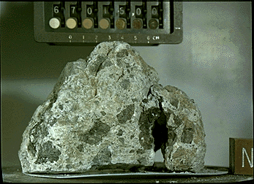
Breccias – fragments mixed together by meteorite impacts
Notes:
With so many craters of all sizes in the lunar highlands, it is no wonder that the rocks have been modified by meteorite impact. This sample was collected in the highlands by the Apollo 16 mission. It is a collection of rock and mineral fragments all mixed together. Geologists call such rocks “breccias.” Many of the rock fragments are themselves breccias, some, such as the dark fragments, were even melted by an impact. (S72-37216)

Slide 33
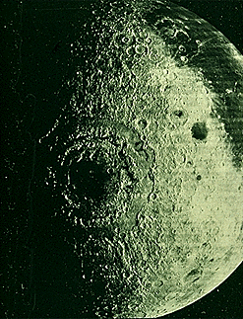
Notes:
The Orientale Basin on the western limb of the Moon was formed by a large impact. About half of this eye-catching structure is visible from the Earth. Note the concentric rings; most scientists believe that the third one is the actual crater rim. The diameter of the third ring is 930 kilometers. There are about 40 such structures on the Moon (all larger than 400 kilometers across), and they may all have formed in a relatively narrow interval between 3.85 and 4.0 billion years ago. (Lunar Obiter IV-187-M)

Slide 34
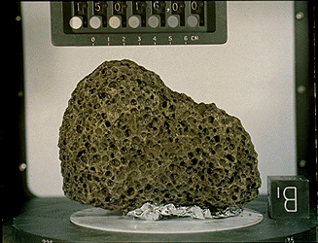
basalt
Notes:
This is a basalt sample returned by the Apollo 15 mission. The brownish color is caused mostly by the presence of the mineral pyroxene. The holes are frozen gas bubbles called “vesicles”, a common feature of terrestrial volcanic rocks. (S71-46632)

Slide 35
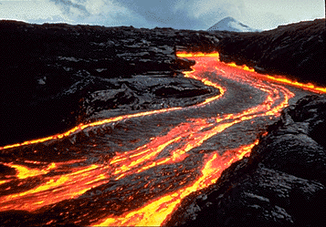
Notes:
For comparison with Hadley Rille, we see here a lava channel about 4 meters across on Kilauea Volcano, Hawaii in 1986. When it was active, Hadley Rille probably resembled this channel, although it was much larger. The lava cools on top, forming a darker skin. Note the levees on the sides, which help confine flow to the channel. The cone in the distance is Pu’u ‘O’o, the source of the lava. (Photograph courtesy of Scott Rowland, University of Hawaii.)

Slide 36
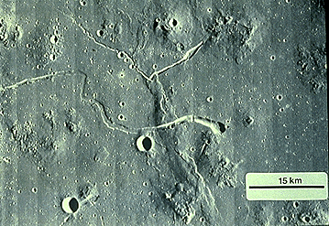
Dome
Rille
Rille
Notes:
Although eruption of most mare basalts did not produce volcanic mountains, there are small volcanic domes in a few places. This shows the Marius Hills, a collection of relatively low domes. Rilles (sinuous lava channels) are also visible, one of which cuts across a mare ridge.
(Lunar Orbiter V-214-M)

Slide 37
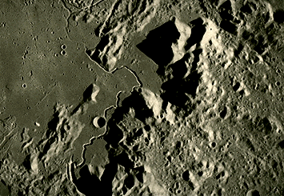
rille
Notes:
The river-like feature in this photograph is called “rille.” Apollo 15 landed near the rim of this rille (called Hadley Rille) between the two largest mountains. Hadley Rille is 1.5 kilometers wide and 300 meters deep. Rilles are channels in which lava flowed during the eruption of mare basalts. All samples collected from its rim are basalts, proving that flowing water did not form these river-like features. (AS15-M-1135)

Slide 38
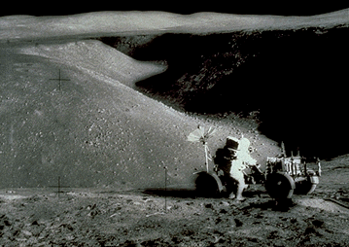
Apollo 15
Notes:
Photograph at the Apollo 15 landing site, looking down into the rille. The crew could have walked down into the rille and sampled rocks from its walls, but time and concern about their safety did not permit it. (AS15-85-11451)

Slide 39
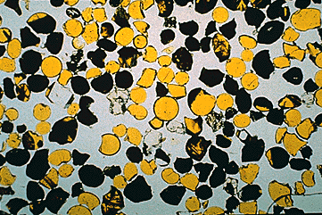
The small drops of lava did not have time to form minerals in it before it cooled, so most of the droplets are composed of glass. The darker ones did have time to crystallize partially, and formed the mineral ilmenite, which is opaque, and so appears black in this photograph
Notes:
Thin slice of some Apollo 17 orange soil. This view is 2.5 millimeters across. The small drops of lava did not have time to form minerals in it before it cooled, so most of the droplets are composed of glass. The darker ones did have time to crystallize partially, and formed the mineral ilmenite, which is opaque, and so appears black in this photograph. (Photography courtesy of Graham Ryder, Lunar and Planetary Institute.)

Slide 40
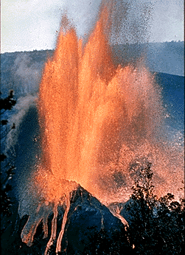
pyroclastic
Notes:
Fire fountaining is another form of volcanic eruption. This one took place in 1959 at Kilauea Volcano and sent lava up to 550 meters into the air. Such eruptions, called “pyroclastic” eruptions, produce loose fragments of hardened lava rather than lava flows. Fire fountaining takes place when the magma contains a high concentration of gases (usually water vapor and carbon dioxide on Earth). (Photograph courtesy of National Park Service.)

Slide 41
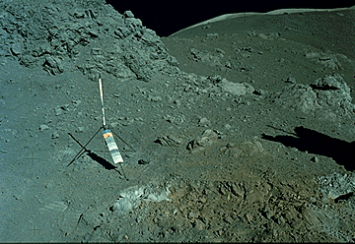
pyroclastic
orange glass
Notes:
Astronauts found a pyroclastic deposit on the Moon at the Apollo 17 landing site. The orange soil is composed of numerous droplets of orange glass that formed by fire fountaining. (AS17-137-20990)

Slide 42
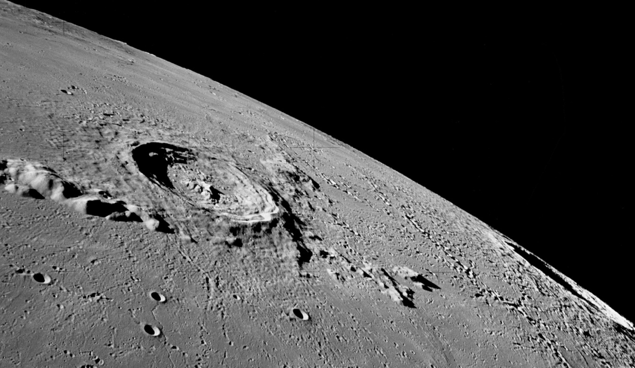
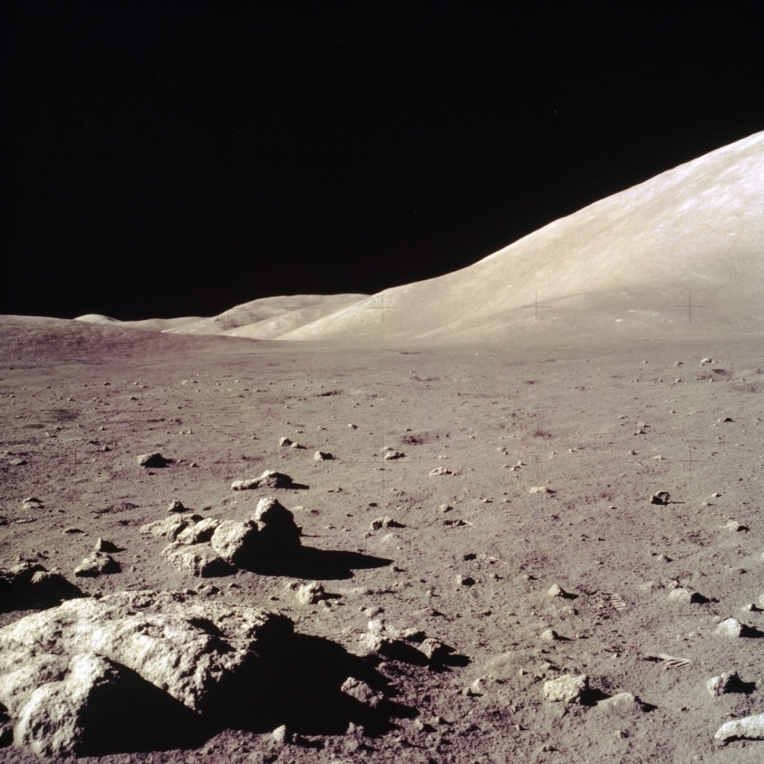
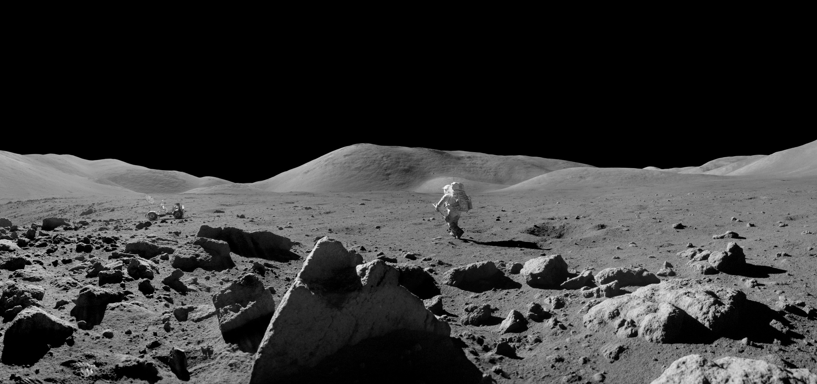

Slide 43
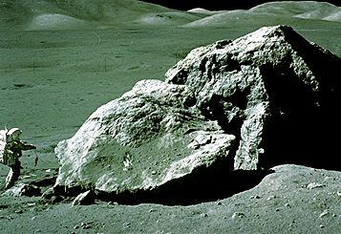
boulder at the Apollo 17 landing site
Notes:
Harrison Schmitt examines a boulder at the Apollo 17 landing site. Geology is more than picking up rocks or whacking them with a hammer. Geologists want to know how different rock types relate to each other. So, Schmitt and other astronauts examined large boulders carefully, sampling rocks from discernible layers. They also tried to see where the boulders came from. In this case, the large rock rolled down from the top of a nearby hill. (AS17-140-21497)

Slide 44
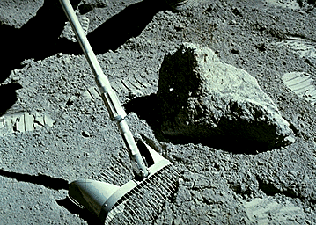
rake samples
Notes:
This slide shows an astronaut collecting walnut-sized rocks with a rake. The samples, aptly named “rake samples,” proved to be extremely valuable because they provided a broad sampling of rock types present at a landing site. Some rock types were present only among rake samples. Also note the nature of the lunar surface. It is mostly powdery, with rock distributed throughout it. (AS16-116-18690)

Slide 45
Caring for the Samples on Earth

Slide 46
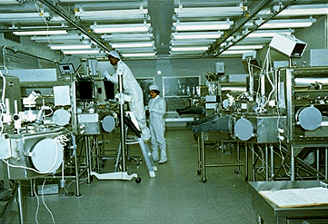
remain in the glass and stainless steel cabinets, filled with inert gases
Notes:
NASA stores lunar samples in pristine condition in the Lunar Curatorial Facility at the Johnson Space Center in Houston, Texas. The samples remain in the glass and stainless steel cabinets, bathed in an atmosphere of pure nitrogen, which is relatively inert, so the samples are not altered by reaction with air. (S80-29345)

Slide 47
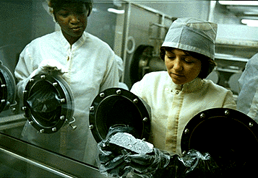
use the black rubber gloves that protrude from the cabinets
Notes:
The skilled technicians who curate the lunar samples wear lint-free suits for cleanliness, but actually never handle the samples directly. Instead, they pick them up and chip samples off them by using the black rubber gloves that protrude from the cabinets. (S82-26777)

Slide 48
Moon Stations – you will need your laptop and science journal
One class period at each station)
A lot of them you need to cut and glue. Do this quickly! In less than 2-3 minutes.
The quicker you go, the less homework you have
Each group of desks is a different station (7 total)
Lots o’ points
Each station will take up it’s own page in your journal
If you are absent, come in before or after school
Please don’t go to the next station if you finish early!

Slide 49
7 Moon Stations
Mercury Station
Moon Rocks Observations
Venus Station
Moon Crash Landing
Mars Station
Apollo Landing Sites
Jupiter Station
Moon Information
Saturn Station
Moon Landforms
Uranus Station
Moon Rock Classification
Neptune Station
Meteorite Observations

Slide 50
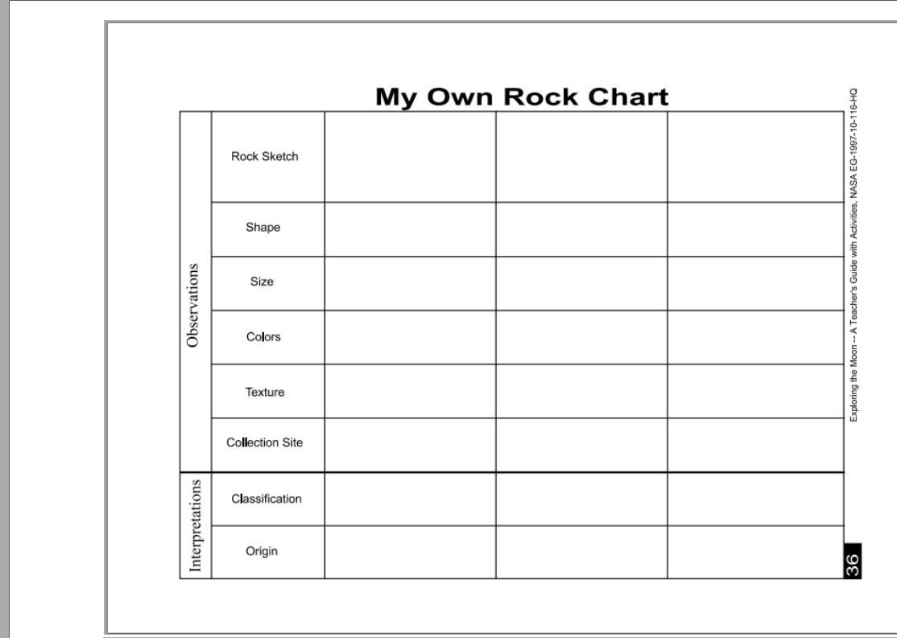
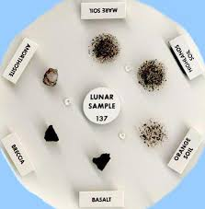
Mercury Station: Moon Rocks Observations PAGE ONE
Analyze rocks brought back by the Apollo astronauts

Slide 51
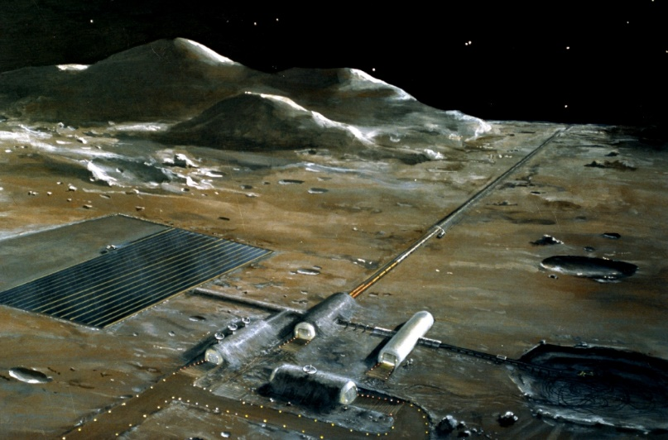
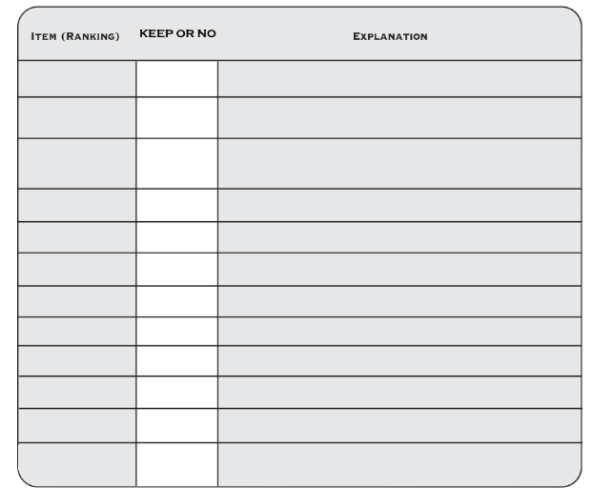
Venus Station: Moon Crash Landing PAGE TWO
Determine what is important to stay alive on the Moon

Slide 52
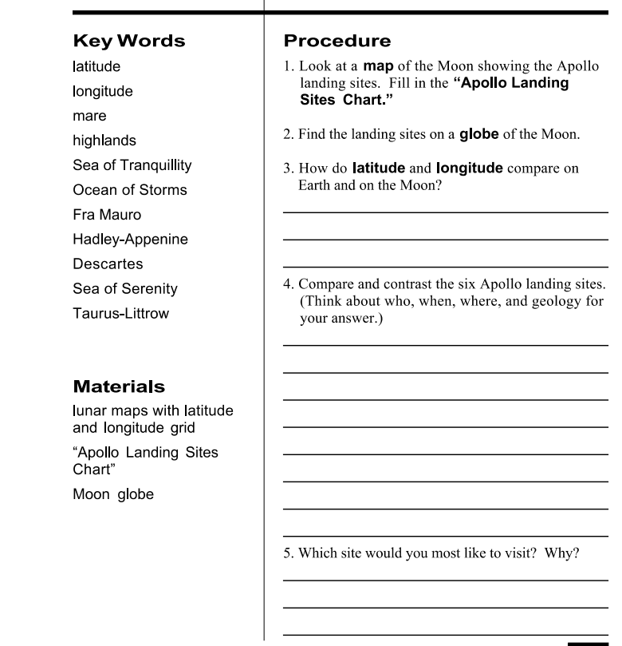
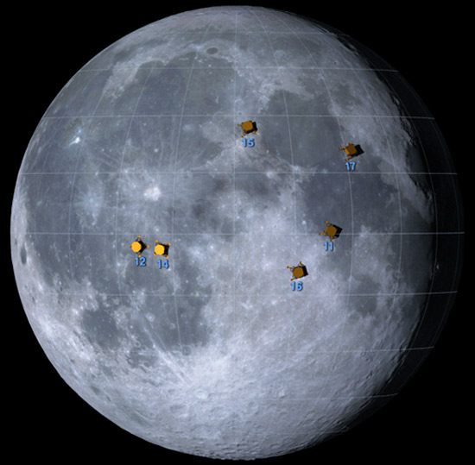
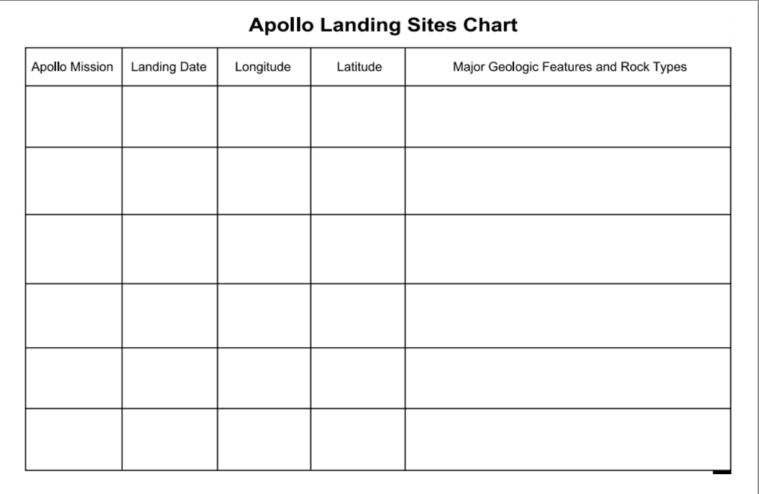
Mars Station: Apollo Landing Sites PAGE THREE
Find information about each of the moon landing sites

Slide 53
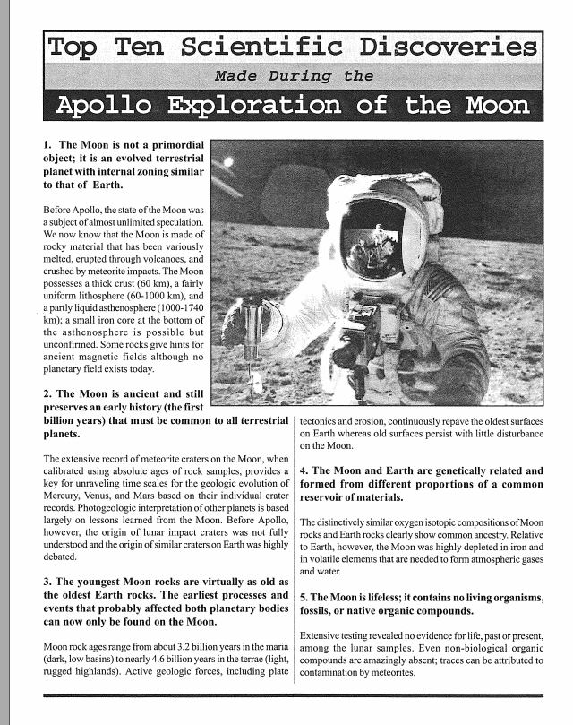
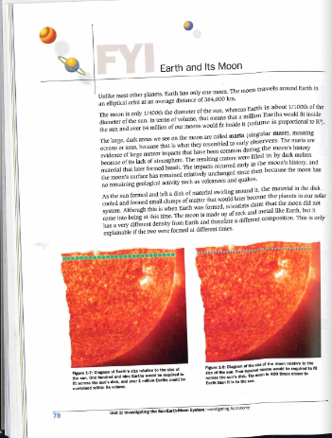
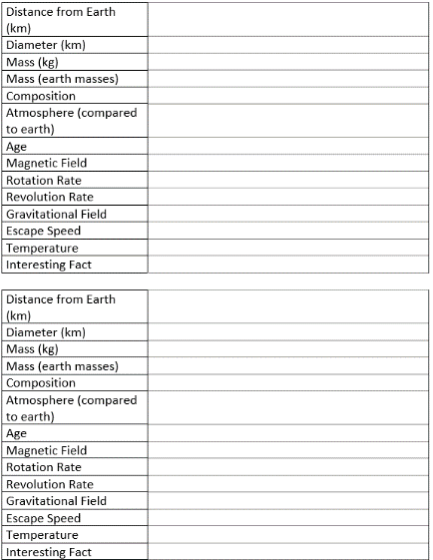
Jupiter Station: Moon Information PAGE FOUR
Find information about the Moon itself

Slide 54
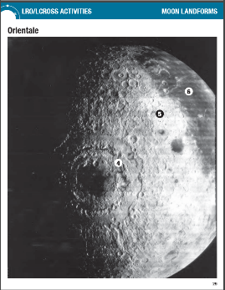
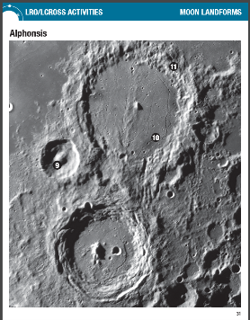
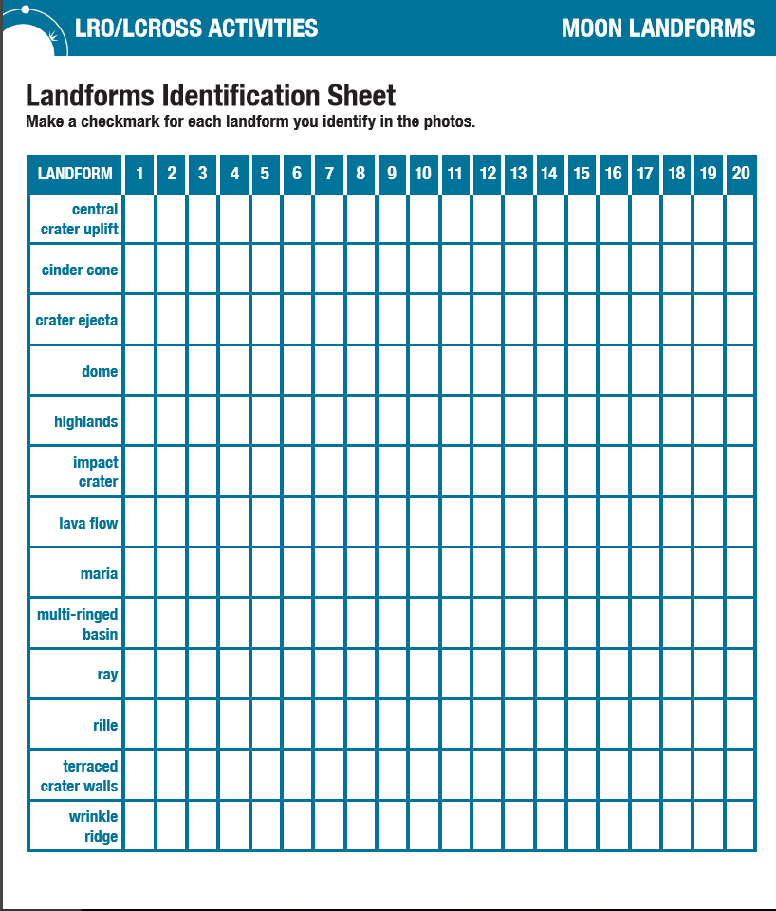
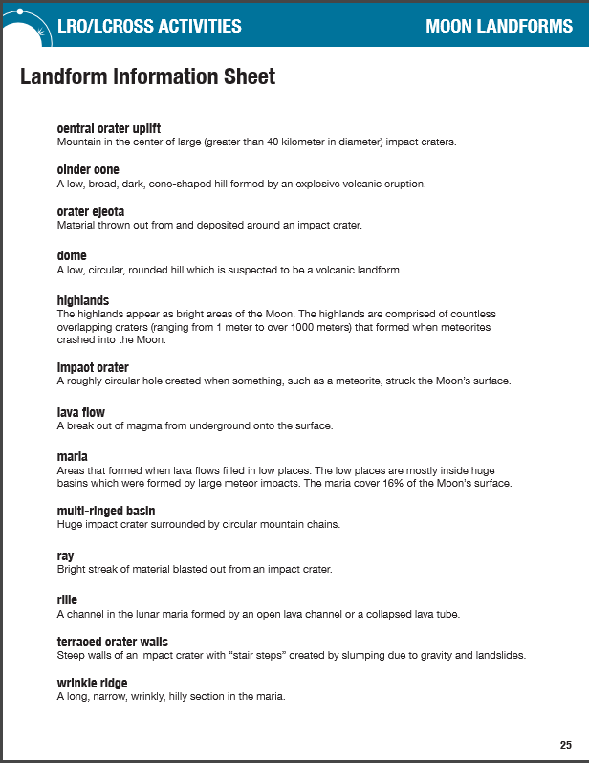
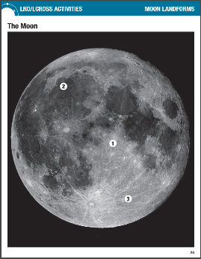
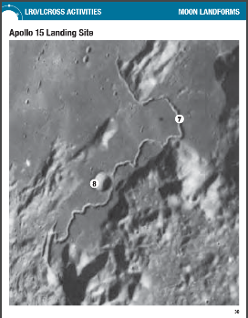
Saturn Station: Moon Landforms PAGE FIVE
Identify different landforms that exist on the Moon

Slide 55
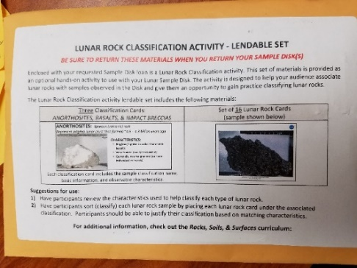
Uranus Station: Moon Rock Classification PAGE SIX
Categorize different types of Moon rocks

Slide 56
Neptune Station: Meteorite Observations PAGE SEVEN
Analyze different types of METEORITES

Slide 58
The end
Till tomorrow

