Slide 1
Make sure you’ve answered the question of the day from yesterday
What can we learn by observing the light (spectrum) of an object?

Slide 2
Understand the electromagnetic spectrum and how it is organized.
Understand what different types of electromagnetic radiation can reveal about astronomical objects.
Understand and describe important properties of electromagnetic radiation.
Understand how technology is used to collect electromagnetic radiation and turn it into images.
Understand what can be learned from analyzing the light from astronomical objects.
Understand how different types of lenses and telescopes work
Understand and describe the quantization of energy at the atomic level
Understand that all objects emit and absorb electromagnetic radiation and distinguish between objects that are blackbody radiators and those that are
Qualitatively describe the shift in frequency in sound or electromagnetic waves due to the relative motion of a source or a receiver

Slide 3
Please just follow the powerpoint and takes notes
I realized we never went over each of the types of EM radiation….
You will be graded on your completed work Tomorrow…

Slide 4
Color this part!
You should have this glued in your journal

Slide 5
Part A: Create this in your science journal! Then use the following slides to complete your chart This is the first thing I’m looking for Tomorrow…
 | Radio | Microwave | IR | Visible | UV | X-Ray | Gamma
1 fact
1 object you can see with it
1 use (human)
Fill me out now as the answer to question number 1
The FYI: from last Wednesday may help ☺

Slide 6
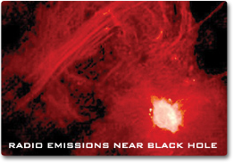
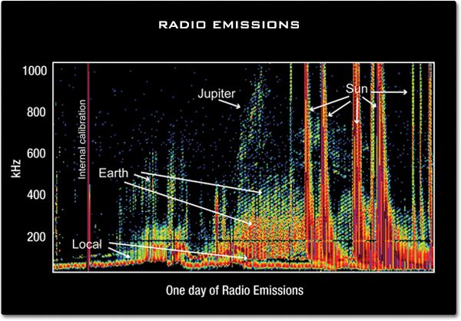
RADIO WAVES!
Radio waves have the longest wavelengths in the electromagnetic spectrum. They range from the length of a football to larger than our planet..
You can tune a radio to a specific wavelength—or frequency—and listen to your favorite music. The radio "receives" these electromagnetic radio waves and converts them to mechanical vibrations in the speaker to create the sound waves you can hear.

Slide 7
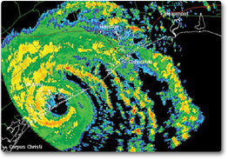
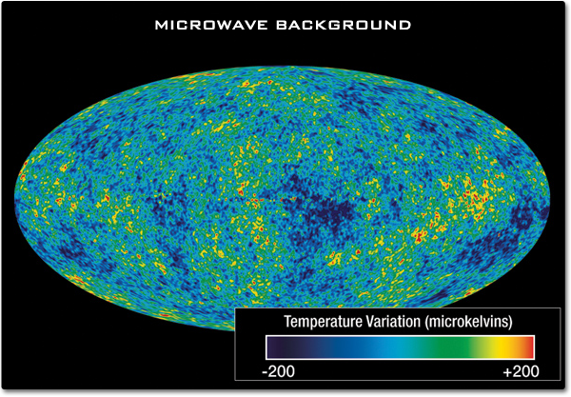
MICROWAVES!
microwave images are used on TV weather news
Microwave ovens work by using microwaves about 12 cm in length to force water and fat molecules in food to rotate. The interaction of these molecules undergoing forced rotation creates heat through friction, and the food is cooked.

Slide 8
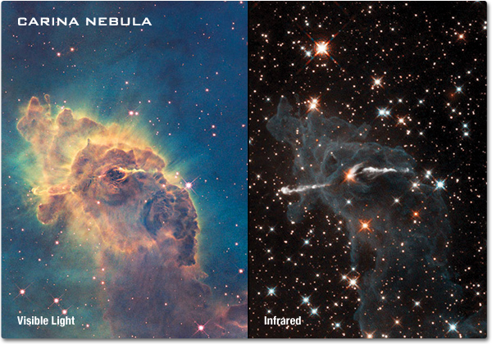
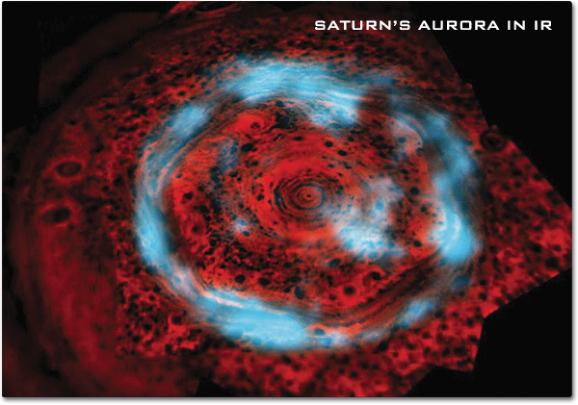
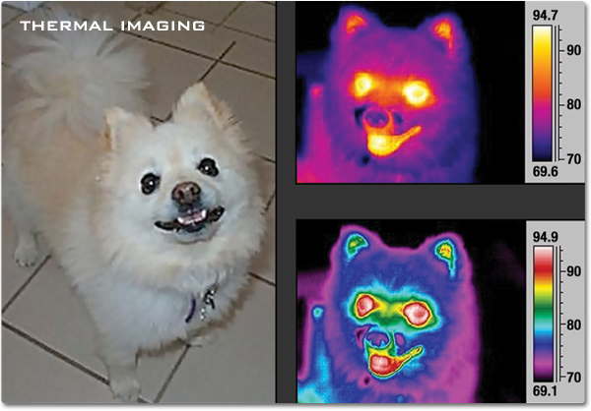
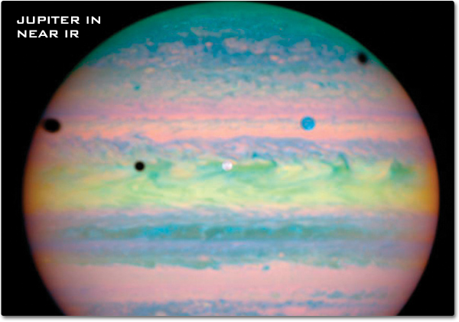
INFRARED RADIATION!
A remote control uses light waves just beyond the visible spectrum of light to change channels.
Infrared lamps (heat lamps) often emit both visible and infrared energy. They can be used to heat bathrooms or keep food warm. Heat lamps can also keep small animals and reptiles warm or even to keep eggs warm so they can hatch.

Slide 9
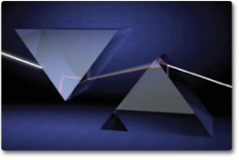
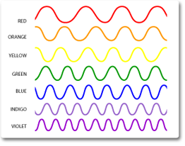
VISIBLE LIGHT
Cone-shaped cells in our eyes act as receivers tuned to the wavelengths in this narrow band of the spectrum. Other portions of the spectrum have wavelengths too large or too small and energetic for the biological limitations of our perception.
As the full spectrum of visible light travels through a prism, the wavelengths separate into the colors of the rainbow because each color is a different wavelength. Violet has the shortest wavelength, and red has the longest wavelength.

Slide 10
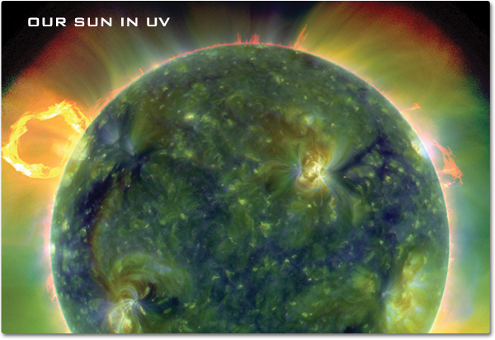
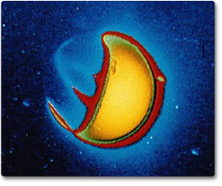
ULTRAVIOLET RADIATION
Ultraviolet (UV) light has shorter wavelengths than visible light.
UV waves are invisible to the human eye, but some insects, such as bumblebees, can see them.
UV light kills cells (hence sunburns), so medical personnel will use UV light to sterilize their equipment

Slide 11
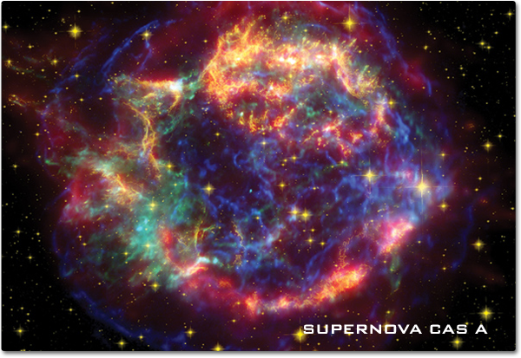
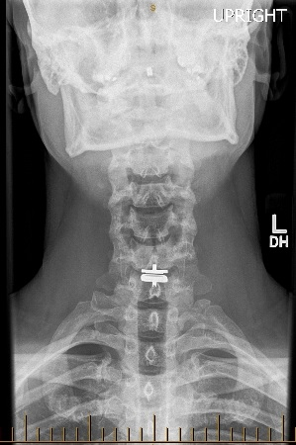
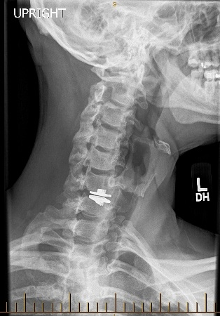
XRAYS
X-rays have much higher energy and much shorter wavelengths than ultraviolet light, and scientists usually refer to x-rays in terms of their energy rather than their wavelength.
This is partially because x-rays have very small wavelengths, and some x-rays are no bigger than a single atom of many elements.
This allows them to go through soft tissue of our bodies, but not through hard things like bones or teeth.

Slide 12
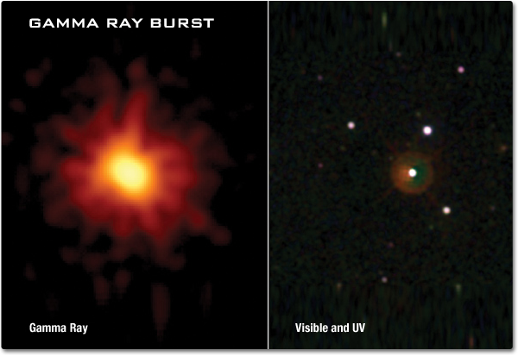
GAMMA RAYS
Gamma rays have the smallest wavelengths and the most energy of any wave in the electromagnetic spectrum.
They are produced by the hottest and most energetic objects in the universe, such as neutron stars and pulsars, supernova explosions, and regions around black holes.
On Earth, gamma waves are generated by nuclear explosions, lightning, and the less dramatic activity of radioactive decay.

Slide 13
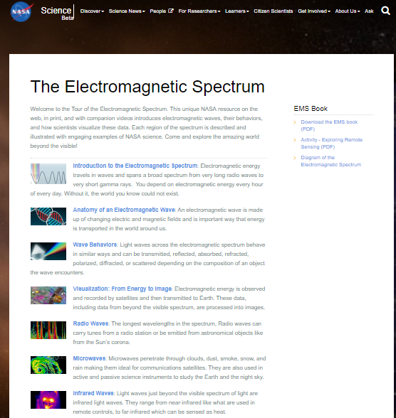
If you need more information
NASA is a great place to turn
https://science.nasa.gov/ems

Slide 14
Based on the following picture, Why do you think we send telescopes to space?
Part B:
This is the second thing I’m looking for on Monday

Slide 15
Region | Wavelength (m) | Size Scale
Radio waves | > 0.3 | Mountains, building
Microwaves | 0.001 - 0.3
Infrared | 7.6x10⁻⁷ - 0.001
Visible | 3.8x10⁻⁷ - 7.6x10⁻⁷ | Bacteria
Ultraviolet | 8x10⁻⁹ - 3.8x10⁻⁷ | Viruses
X-rays | 6x10-¹² - 8x10⁻⁹ | Atoms
Gamma Rays | < 6x10⁻¹² | Nuclei

Slide 16
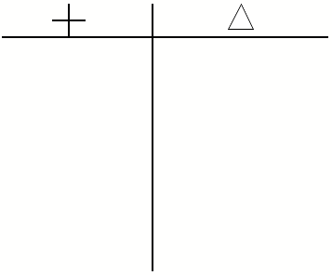
Now!!
Part C:
Pick 2 types of radiation.
Create a T-chart that compares the types.
More info on the next slide

Slide 17
now.
Pick 2 types of radiation.
Create a chart that compares the types.
Include 8 characteristics.
Wavelength
Size of wave
Frequency
Benefits/Harm to humans
Astronomical discoveries made
3 that you choose
Write one paragraph explaining which type you think is more helpful when it comes to observing the universe.
This is the third thing I’m looking for on Monday

Slide 18
Part D: Answer these 3 questions
What is electromagnetic radiation?
What can different types of electromagnetic radiation reveal about astronomical objects?
What are the important properties of electromagnetic radiation and how are they typically organized?
This is the fourth thing I’m looking for on Monday

Slide 19
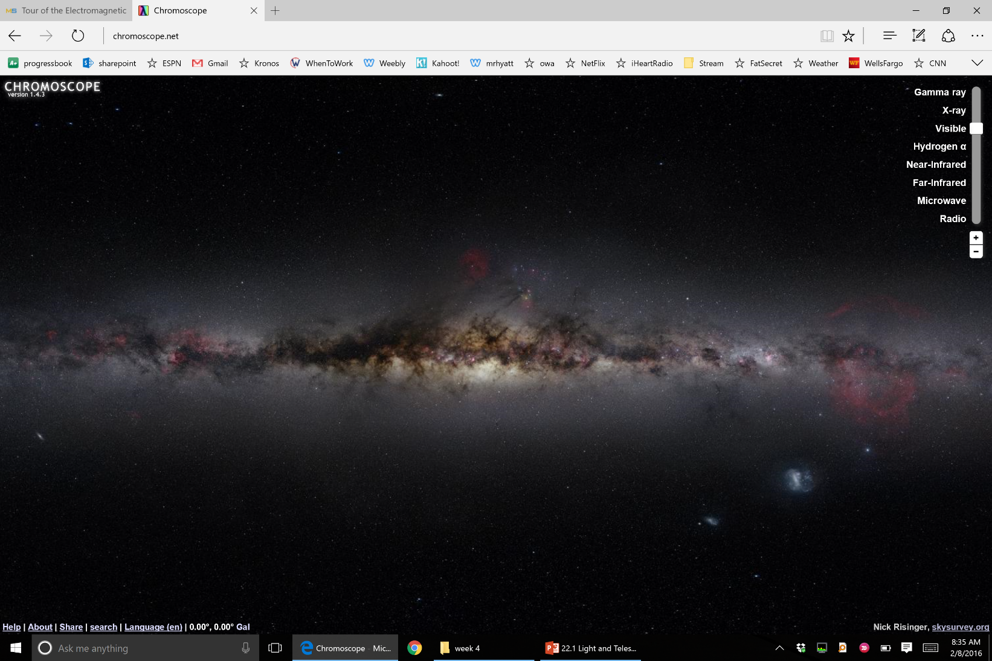
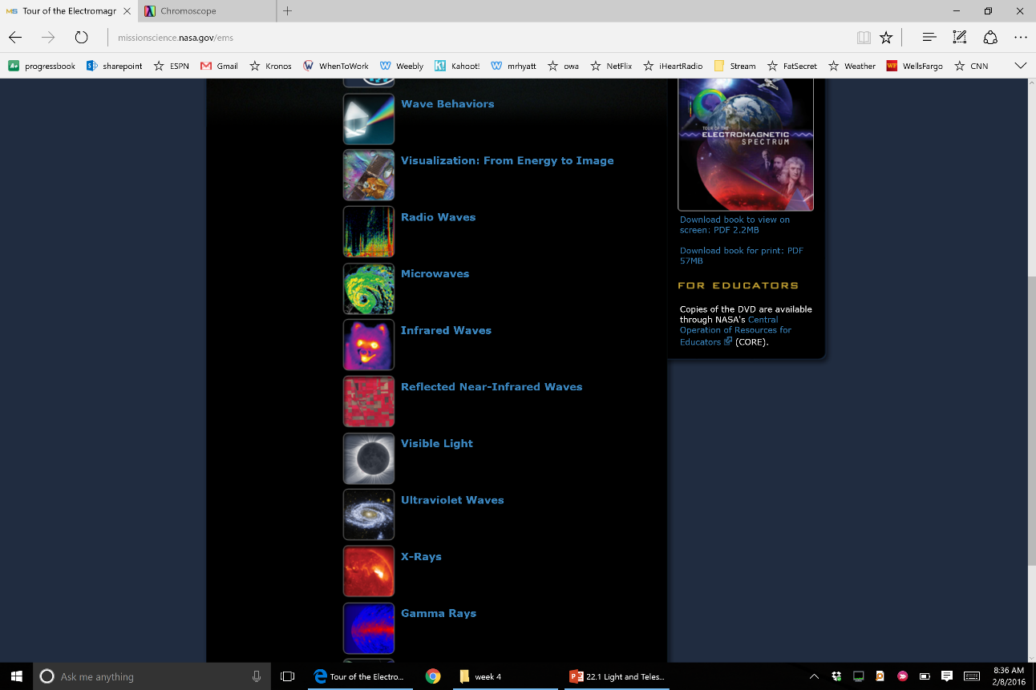
Homework
This is the fifth thing I’m looking for on Monday
You were just awarded a grant to build a telescope
EXTRA INFORMATION
https://science.nasa.gov/ems
http://www.chromoscope.net/
Explain which part of the EM spectrum your telescope will be built to see. Does it need to be in space or can it be on the ground? what kind of objects will you be looking for with your particular telescope. Why did you choose to look in this particular part of a spectrum. Write a paragraph answering these questions.1 paragraph explaining choice.

Slide 20
What am I looking for on Wednesday?
4
5
1
2
3

