Slide 1
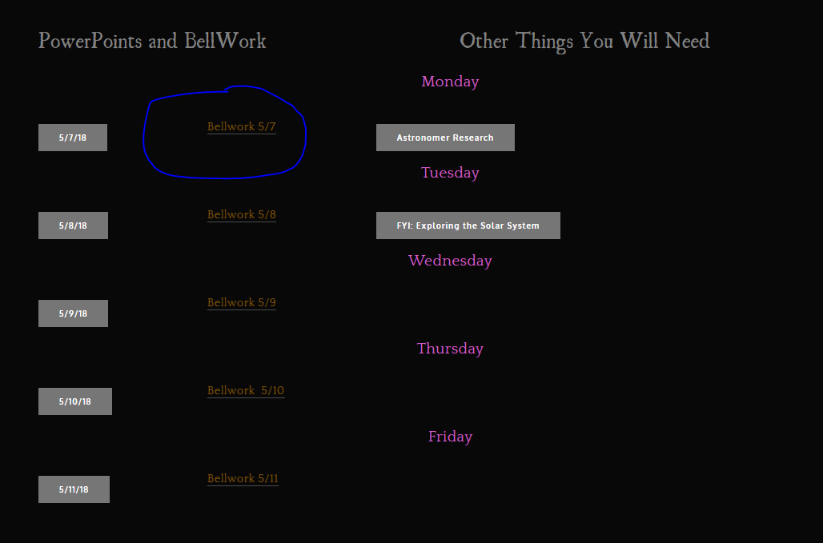
☺
You have bell work today

Slide 2
Current Events
Assigned Monday
Due Every Friday for the rest of the Year.
You will have 4 total
You will turn it in through Google Classroom
The assignment is already posted

Slide 3
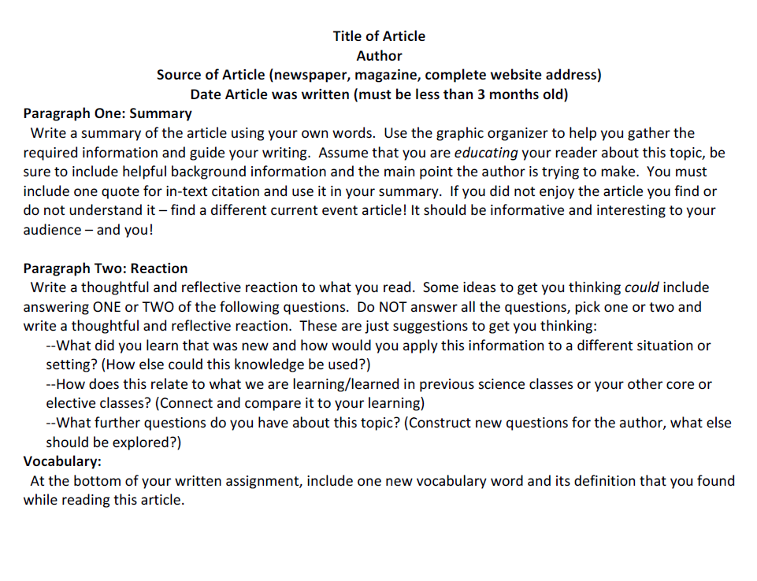

Slide 5
Solar System Scientists

Slide 6
Solar System Scientists How has our view of the solar system changed over time?

Slide 7
School is not done!!
We still have 6 days before senior EOCs
We have 6 Bellworks
We have 4 assignments
We have 1 quiz
Our class average is a 56.5%
11 Ds
68 Fs

Slide 8
In notebook:
Name and dates
Fact 1 (paraphrased)
Fact 2 (paraphrased)
Circle the one you think is the most important discovery/fact
Aristotle
Ptolemy
Copernicus
Bruno
Brahe
Galileo
Kepler
Cassini
Huygens
Newton

Slide 9
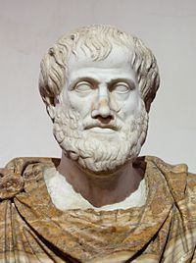
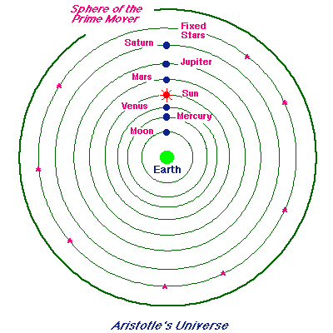
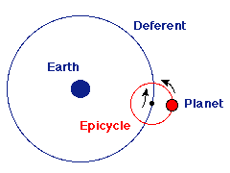
Aristotle (384-322BC)

Slide 10
Aristotle
Plato’s best student
Philosopher
Everything had a natural state
Knew that Earth is a sphere
Universe is geocentric (earth centered)
Everything is made of 5 elements
Fire, Water, Earth, Air, Quintessence

Slide 11
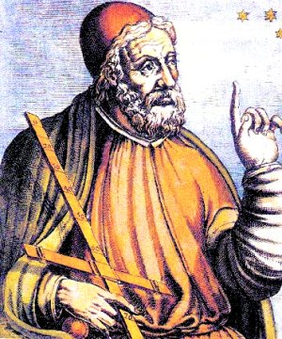
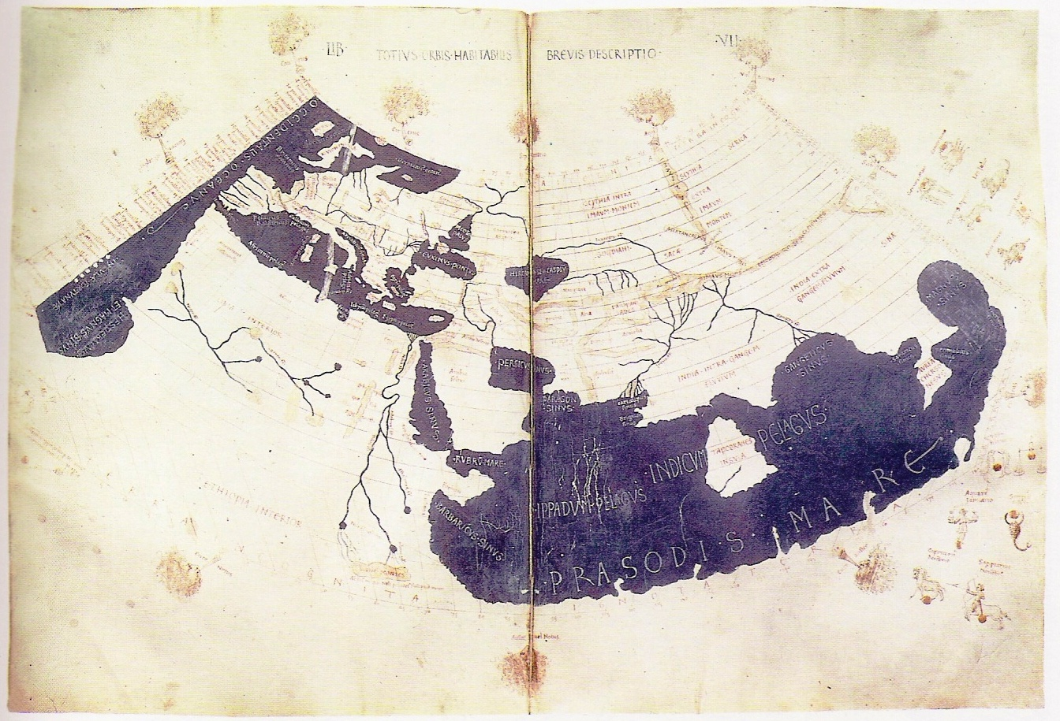
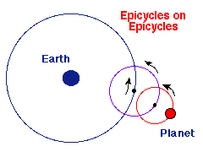
Claudius Ptolemy (90 – 168)

Slide 12
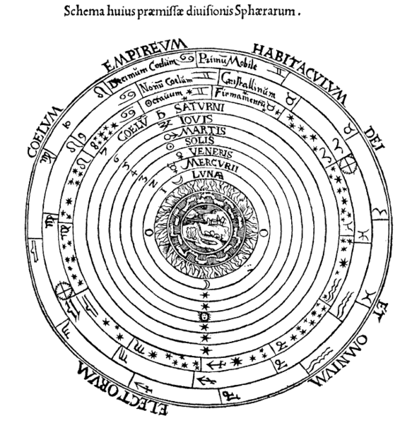
Ptolemy
Greek, living in Alexandria (Egypt)
Universe is geocentric
Planets move on epicycles
His method was used for almost 1500 years
Wrote book of astronomical knowledge ‘Almagest’ – 48 constellations

Slide 13
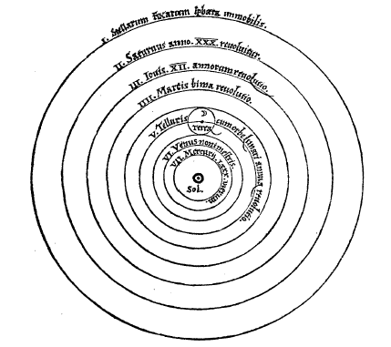
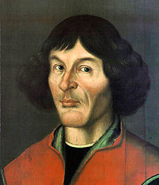
Nicolaus Copernicus (1473-1543)

Slide 14
Copernicus
Priest, Mathematician, Astronomer
Heliocentric solar system, earth is moving
Mentioned idea in 1514, with little support
Perfected it until published in 1543 ‘On the Revolutions of Heavenly Spheres’
This model predicted the planets location worse the Ptolemy’s did
Died weeks after publication.
The church banned his book and tried to destroy all copies of it

Slide 15
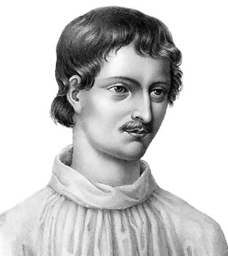
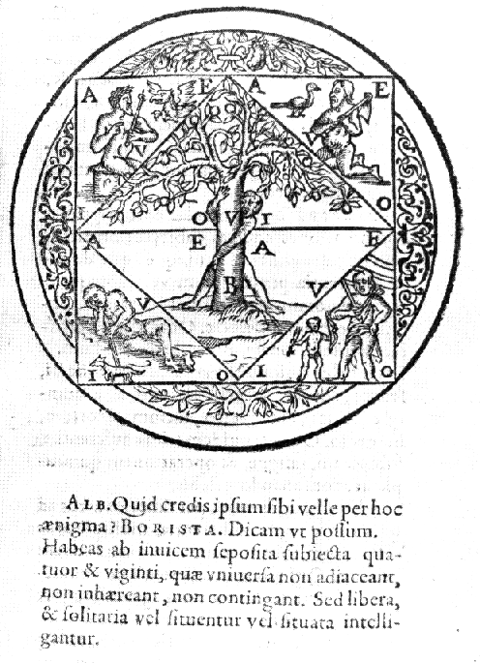
Giordano Bruno (1548-1600)

Slide 16
Bruno
Proposed that the stars were distant suns
First to envision the universe as infinite
Thought that planets moved based on their own momentum
Though a Catholic friar himself, he was burned at the stake by the church for his beliefs
Given the chance to renounce his views but refused

Slide 17
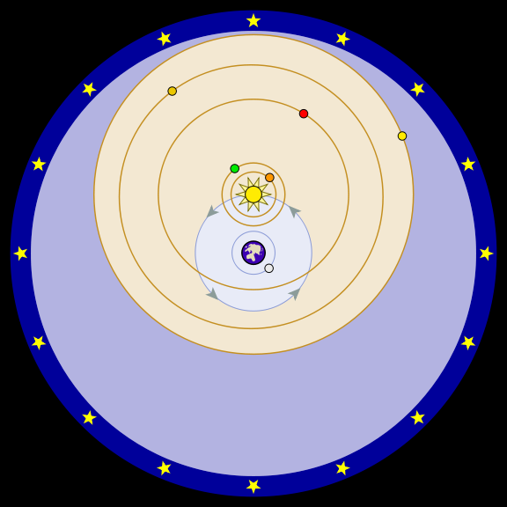
Tycho Brahe (1546-1601)

Slide 18
Brahe
Tychonian model of the solar system
Known for years and years worth of observations unmatched in quantity and accuracy
No telescope
Not enough math knowledge
Tried to make Copernicus model work

Slide 19
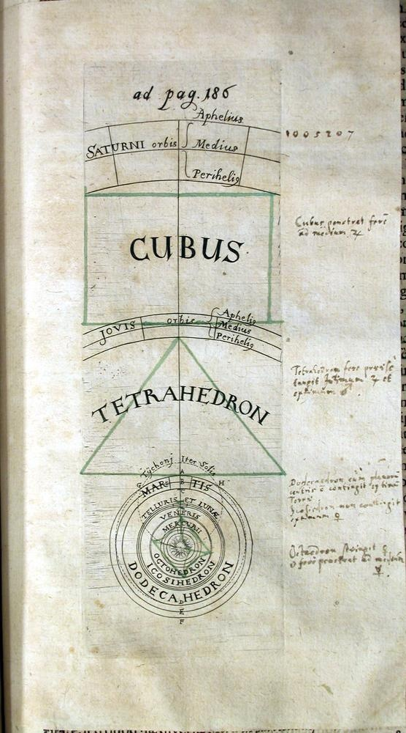
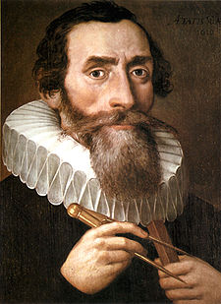
Johannes Kepler (1571-1620)

Slide 20
Kepler
Looked for harmony in the universe
Worked for Brahe, (very good at math!)
Produced the most accurate astronomical data tables of the time
Used data to develop his 3 laws of planetary motion, ellipses, area, orbit (inspired Newton to figure out how)
support for Copernicus

Slide 21
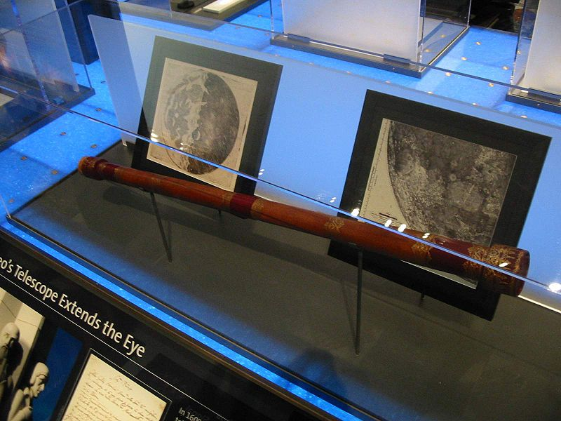
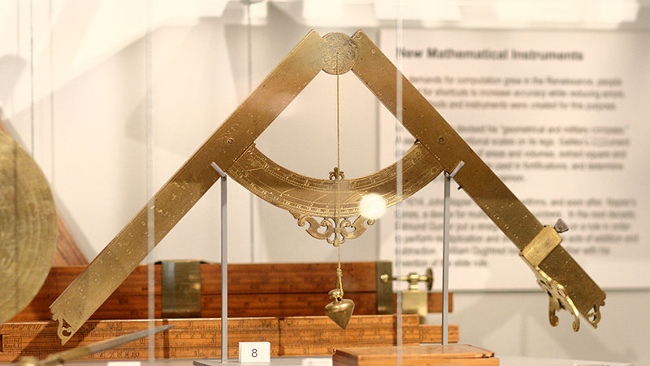
Galileo Galilei (1564-1642)

Slide 22
Galileo
First to use telescope for astronomical observations,
Discovered moons of Jupiter, phases of Venus, milky way made of stars, sunspots
Considered the “father of modern physics” (inertia)
First to do actual science
Published ‘Dialogue on 2 World Systems’ but then forced to renounce his beliefs, placed under house arrest for last 9 years of his life
more support for Copernicus

Slide 23
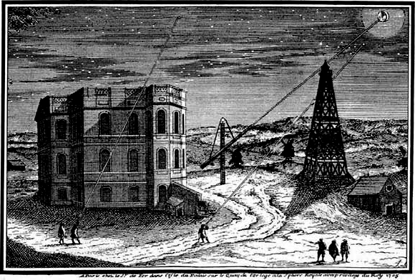
Giovanni Cassini (1625 -1712)

Slide 24
Cassini
observed and published surface markings on Mars
determined the rotation period of Mars and Jupiter
discovered four Saturn Moons: Iapetus, Rhea, Tethys and Dione
discovered the Cassini Division in the rings of Saturn
(shares with Robert Hooke) credit for the discovery of the Great Red Spot on Jupiter
first to observe differential rotation within Jupiter's atmosphere.

Slide 25
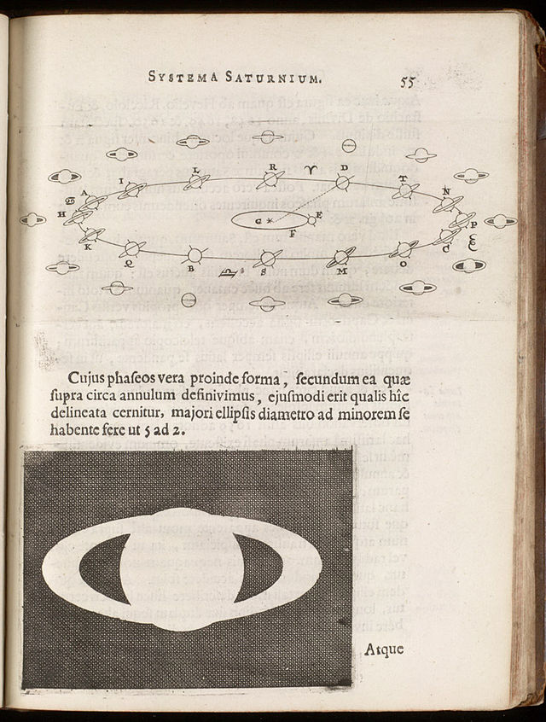
Christian Huygens (1629 – 1695)

Slide 26
Huygens
early telescopic studies of the rings of Saturn
discovery of moon Titan
invention of the pendulum clock and other investigations in timekeeping.
published major studies of mechanics, optics, and probability

Slide 27
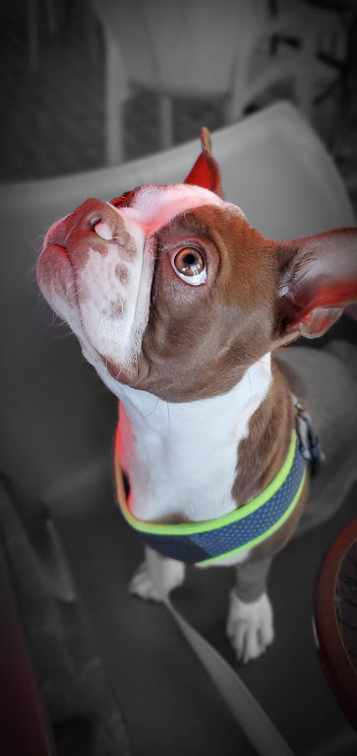
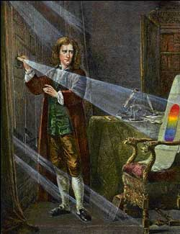
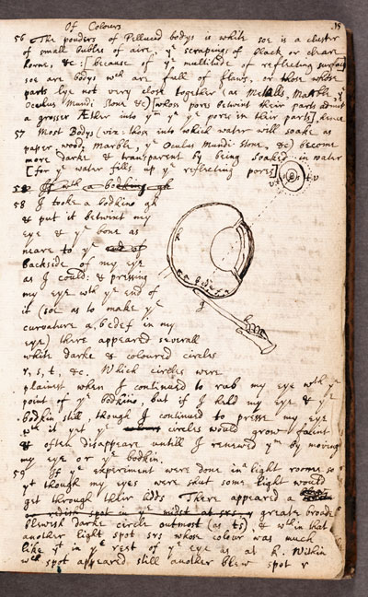
Isaac Newton (1642-1727)

Slide 28
Newton
Studied math (invented calculus), gravitation, mechanics, optics, sound, alchemy
Published ‘Mathematical Principles of Natural Philosophy’
*in it, he used the Latin word gravitas (weight) for the effect that would become known as gravity
Used ideas from Copernicus, Galileo and Kepler to become the most influential scientist ever

Slide 29
I do not know what I may appear to the world, but to myself I seem to have been only like a boy playing on the sea-shore, and diverting myself in now and then finding a smoother pebble or a prettier shell than ordinary, while the great ocean of truth lay all undiscovered before me.
–Isaac Newton

Slide 30
We cannot teach people anything; we can only help them discover it within themselves. -Galileo Galilei
Those things which I am saying now may be obscure, yet they will be made clearer in their proper place.
-Nicolaus Copernicus

Slide 31
In Summary:
Answer the question from the beginning of the day!
How has our view of the solar system changed over time?

Slide 32
Choose 1 scientist – Due Tomorrow
research:
Life & Death
Work
Publications
Discoveries
Rumors
Work with other scientists or people
Famous quotes
Any other important facts
Dates
Pictures
Scientist Profile
Page 1:
1 picture
1 discovery and explanation
3 facts
1 quote
Page 2:
Everything Else!
sources for EVERYTHING
must have a source for each piece of information

Slide 33
Chose 1 from these scientists
E. Halley
L. Kraus
A. Jump Cannon
G. Gamow
P.S. Laplace
S. Chandrasekhar
F. Hoyle
R. Penrose
F. Zwicky
M. Brown
A. Eddington
K. Schwarzschild
A. Sandage
H. Swann Leavitt
H. Shapley
E. Hubble
C. Messier
G. Kuiper
C. Sagan
N. Tyson
S. Hawking
C. Herschel
W. Herschel
K. Thorne
J. Oort
B. Greene
E. Hertzsprung
H. Russell
C. Tombaugh
F. Drake

Slide 34
Find all this information about your chosen scientist
Name
Where they are from
Years Living
Field of Study
Where did they get their education
2 Facts of early life
2 facts of adult/later life
2 other facts
Discovery they made
Where/When did they make this discovery
How their discovery is related to Astronomy
How their work has impacted society as a whole
Famous Quotes
Other scientists they have worked with
Their books or publications
Any other important facts
ALL sources for YOUR information
1 picture of your scientist
1 picture of what they are famous for

