Slide 1
Learning Goals:
I will:
understand the properties of different types of galaxies.
understand how the universe came to be what we observe today.
understand how astronomers use astronomical objects (standard candles)
Understand how we use a distance ladder to estimate the size of the universe and to measure large distances in the universe.
understand how astronomers determine the age and size of the universe?.
4. Complex Knowledge: demonstrations of learning that go aboveand above and beyond what was explicitly taught. 3. Knowledge: meeting the learning goals and expectations. 2. Foundational knowledge: simpler procedures, isolated details, vocabulary. 1. Limited knowledge: know very little details but working toward a higher level.

Slide 2
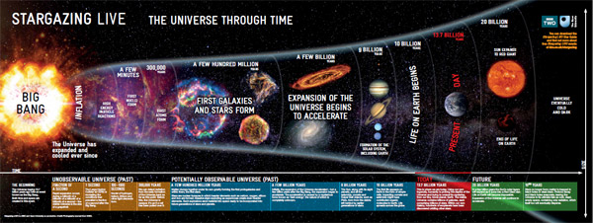
4/27/18
Why can’t we know exactly what happens all the way back to “time=0” or the “big bang?”

Slide 3
Disclaimer
Your Brain Hurt today…
Leading Astrophysicists aren’t exactly sure about this topic…
I’ll present the latest ideas, but they may be completely wrong

Slide 4
Dark Matter and Dark Energy

Slide 5
Questions of the Day
What is Dark Energy and Dark Matter?
How do we even know they exist?

Slide 6
Matter in the Universe Today Reminder $E=mc^{2}$
Evidence gathered from WMAP shows that ALL of the matter in the universe is composed of three types of matter:
Cold dark matter – slow (and large particles)
Hot dark matter – relativistic (speed of light) (and small)
Baryonic matter – regular matter
Data from galaxy rotation curves indicate that around 90% of the mass of a galaxy cannot be seen?!?!?
Notes:
Today, we still don’t really know that much about dark matter except that it doesn’t interact with light but still has mass.
Example: our galaxy supercluster is moving towards a giant clump of dark matter, known as the great attractor.

Slide 7
~15%
~4%
~81%

Slide 9
Rotation of Galaxies
Without Dark Matter
With Dark Matter

Slide 10
Galaxy Clusters orbiting a common center of gravity

Slide 11
Gravitational Lensing

Slide 12
Dark Matter around our own Milky Way Galaxy (determined through weak gravitational lensing)

Slide 13
https://www.youtube.com/watch?v=C8ZOgKIsqEA
https://www.youtube.com/watch?v=C8ZOgKIsqEA

Slide 14
https://www.youtube.com/watch?v=VL6ZNHiqP9A

Slide 15
Web-like large-scale distribution of dark matter
Near – recent
Far -- older
Notes:
This three-dimensional map offers a first look at the web-like large-scale distribution of dark matter, an invisible form of matter that accounts for most of the Universe's mass. The map reveals a loose network of dark matter filaments, gradually collapsing under the relentless pull of gravity, and growing clumpier over time. The three axes of the box correspond to sky position (in right ascension and declination), and distance from the Earth increasing from left to right (as measured by cosmological redshift). Note how the clumping of the dark matter becomes more pronounced, moving right to left across the volume map, from the early Universe to the more recent Universe. The distribution of mass in the Hubble Space Telescope COSMOS survey, determined from measurements of weak gravitational lensing. The field of view covers about nine times the size of the full moon, and the third dimension stretches from redshift z=0 to z=1. The figure shows one isosurface of the gravitational potential.

Slide 16
What is Dark Matter?
No Clue!
Dark matter: matter that has never been directly observed in the laboratory, its existence is suspected because of its gravitational influence on things we can see
Dark Matter around our own Milky Way Galaxy (determined through weak gravitational lensing)

Slide 17
Matter and Energy are equivalent

Slide 18
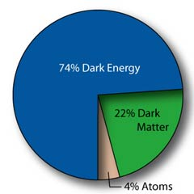
What’s the Universe Made Of?
4 % Atoms
22% Cold Dark Matter
74% Dark Energy
Agreement?????

Slide 19
What is Dark Energy?
Dark energy: this is a truly bizarre form of matter?, or perhaps a property of the vacuum itself, that is characterized by a large, negative pressure (repelling force). This is the only form of matter that can cause the expansion of the universe to accelerate, or speed up.

Slide 20
Nature of Expansion Today
Evidence of Type 1a supernovae and CMB radiation show that the expansion is accelerating, driven by dark energy.
Dark energy comprises ~74% of all energy and permeates all space.
It is likely that this dark energy has always been throughout the universe, but when the universe was younger and much smaller, gravity was stronger than dark energy.
This acceleration could be described by Einstein’s cosmological constant.
Today, dark energy is still very misunderstood.
Notes:
Due to expansion, dark energy is dominant now.

Slide 21
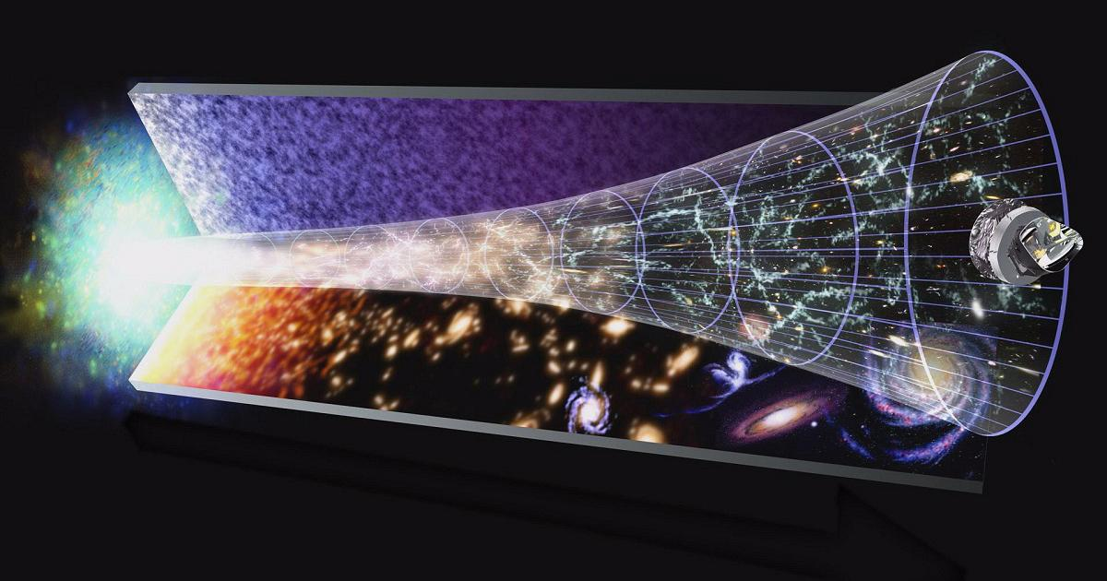

Slide 23
https://www.youtube.com/watch?v=7Yc2iVxF_Ek
https://www.youtube.com/watch?v=7Yc2iVxF_Ek

Slide 24
https://www.youtube.com/watch?v=ATwVApurIQ4

Slide 25
Compare and Contrast
Dark Matter
Dark Energy

Slide 26
Compare and Contrast
Dark Matter
Dark Energy
One hypothesis about what it is
One way that we know it is there

Slide 27
https://www.youtube.com/watch?v=QAa2O_8wBUQ

Slide 28
What is Dark Energy and Dark Matter? How do we even know they exist?

